Slide 1
Unemployment and poverty in Iraq...a nightmare that haunts the dreams of those looking for a chance to live SUPERVISED BY Prof. Anwar Alfaidhi BY Shifaa Rasho Haider

Slide 2
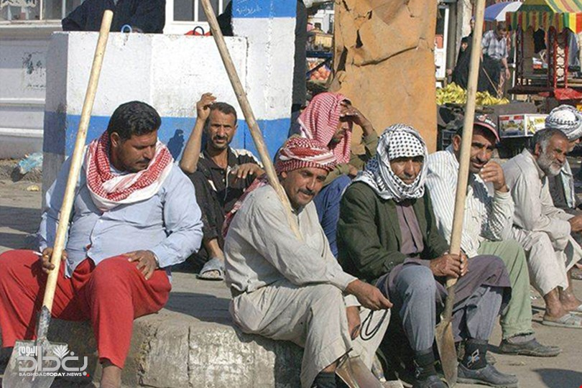
According to statistics poverty rates will rise in Iraq in the coming years, despite reaching hidden rates for the last 3 years.
According to the latest statistics issued by the Ministry of Work and Social Assurance at the end of the last month, the number of unemployed people in Iraq is about 1.6 million, of different categories, including 10,000 graduates.

Slide 3
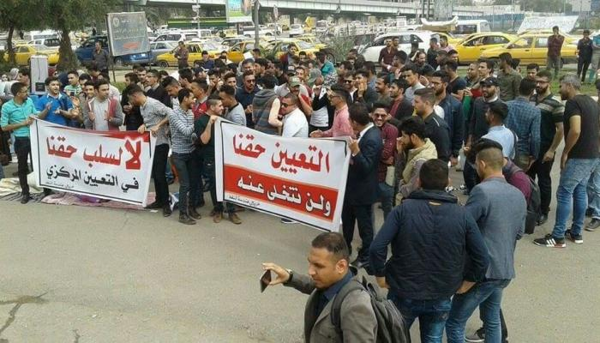
According to UN statistics, more than 45,000 people graduate annualy from universities and institutes in Iraq, and in 2019 alone there were about 50 ,000 graduates, and only about 2,000 of this number were appointed the rest are all unemployed, where do they go and what is their fate ?
Young Iraqis, graduates from departments of engineering, science, agriculture, technology and law department, don’t have enough experience in their field of work, so they resorts to selling vegetables and other low level jobs to live and feed their families .

Slide 4
As a new graduates, when we apply to civil organizations or any privet sector job, they ask for the years of work experience, and any extra qualifications and we discover that the information we gained through the years of study in colleges was not enough.
So we think the solutions will be :
Opening workshops and granting recognized certificates to young people .
Private sector support ( for example, anyone who has a small private project must have some kind of support or facilities).
The action plan for any project must developed by specialists .
Supporting graduated students of the fields of engineering, science, agriculture, technology departments, law, will leads to flourish the economics.
Support gifted people in drawing, fashion designers and small shop owners .

Slide 5
THANKS FOR LISTENING
ANY QUESTION ?

