Slide 1
Unemployment… Problems and solutions
University of Mosul
College of Science
Department of Chemistry
Group (S06)

Slide 2
Under Supervisors Dr. Ammar Abdulsattar Ibrahim Mariam Fawzi Habeeb
Lamiaa Suhail Najm | Estabraq Adnan yousif
Hala Rafa Salim | Ghufran Asmet Mahmoud
Zainab Luqman Abdul razzaq | Eman Abdulrazzaq Abdullah
Doaa Ahmed Hamid`

Slide 3
Unemployment: The inability to find a job
Or:
A group of individuals who have certain advantages or primary or higher university certificates, but they did not find a suitable job opportunity for them and therefore do not have a certain livelihood that makes them easily earn their needs

Slide 4
Unemployment is one of the most dangerous negative phenomena prevalent in the world, which has negative effects on the life of the individual and society in general. Despite the many attempts to address and eliminate this problem, we still suffer from it severely. Below we will highlight the issue of unemployment, and the most important causes that lead to it, and ways to treat it.

Slide 5
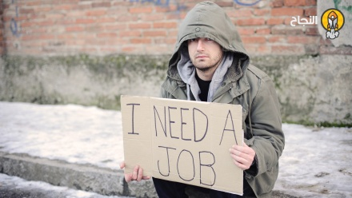

Slide 6
Among the main causes of unemployment are:
1- The prevalence of wars that affect societies in general
2- The government's failure to provide adequate support to the business sector.
3- Economic problems in the country
4-Increasing the population in return for the decrease in the number of job opportunities
5- Too much reliance on foreign workers

Slide 7
Damage caused by unemployment:
1- Low economic level
2- Increasing the crime rate
3- People turn to drugs and addiction
4- The psychological state of the individual

Slide 8
Ways to eliminate unemployment:
1- Creating simple projects for the individual and providing job opportunities
2- Conducting courses to obtain experience and obtain a certificate that qualifies him to get work
3- Government or university support for simple projects
4- Supporting the affluent and the rich for graduates with small amounts

Slide 9
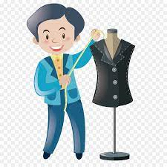
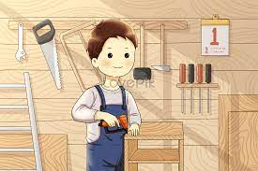

Slide 10
Girls

Slide 11
Recommendation:
We know that there is no appointment in our country, and if it is found, it is few.
My message to every graduate student or at the gates of graduation is to try to find a job that will benefit him, and this has a positive aspect that will be reflected on him. He will develop himself and at the same time will earn money that qualifies him to complete any path he seeks for.
On the other hand, there are many hobbies that can be practiced and marketed in social networking sites or local markets and benefit from them.

