Slide 1
Community work helps in reducing unemployment crisis
Shaymaa Nabeel AlNuaimi
University of Mosul - College of medicine
ED03
Dr. Maan Dr. Hiba

Slide 2
Community work
Returning back to my first day at Mosul Medical College, I was wondering how medical students can be more effective and participate in serving their communities! How they can break the stereotype of being isolated!
There were many questions in my mind and without any answers until one day I’ve attended a public health field event related to the international federation of medical student association (IFMSA-Iraq) in 2018 this was my beginning in this federation that has changed my life totally.
It’s a non- profit and non-governmental organization that aims to serve the community in different aspects including public health, human rights, women's rights, medical education…etc. and it’s present in about 170 countries around the world.

Slide 3
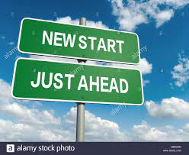
A chance to find yourself then find your job
After joining this federation, It gave me the opportunity to find myself, to improve my skills specifically in leadership and communication by holding positions and being project manager of many activities, to share my ideas and even applying of these ideas through organized activities.
It also gave me the opportunity to meet talented medical
students, to be more oriented and to have friends from
different cultures on national and international levels.

Slide 4
Trainings
-Protection against extreme violence training sponsored by UNFPA and Ministry of youth and sport, Al-Hadba’a sport center, Mosul, Iraq, 2020.
-NMO management training, IFMSA-Iraq, Al-Mansour Melia hotel, Baghdad, Iraq, 2018.
-Capacity building trainings including (Communication skills, leadership skills, team building and problem-solving techniques), IFMSA-Iraq, Mosul, Iraq, 2019.

Slide 5
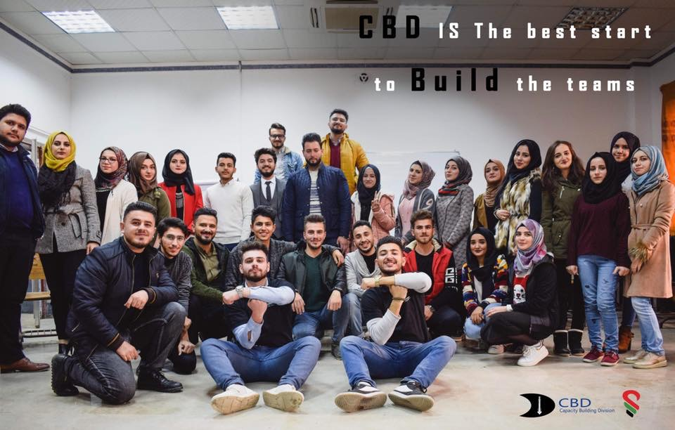

Slide 6
Community work and activities:
IFMSA-Iraq positions:
1-President of Mosul local committee term 2020-2021.
2-Local public health officer/LPO term 2018-2019.
3-Head of SCOPH (public health issues) session team at Mosul break,March2019.
"Mosul break is an national event that is held annually by IFMSA-Iraq where 200 medical students from all over the Iraq gather for 4 days to attend sessions and training workshops in many topics (human rights, women issues, public health issues…etc.), to share ideas and to take the right decisions that serve our community."
4-Contributor in writing AMR (antimicrobial resistance) policy document which is the
first policy in the history of IFMSA-Iraq, (April – Aug) 2019.

Slide 7
IFMSA-Iraq activities: 1-2
1-Women rights activities including:
*Participant in orange the world campaign (to spotlight gender-based violence issue), November 2018.
*Participant in international women’s day activities, March of each year.
2-Public health field events: project manager of more than 15 activities related to public health targeting public people in Mosul city to raise awareness about many topics including:
-Mental health activities:
*Stressed? Overcome it board (we made a board about stress on medical students and how it affects their life and mental health). Date: 10-3-2019.
*Anti-bullying session (It was about bullying, its causes, its effects on society in general and on students in school), Date: 19-3-2019.
*Anti-bullying campaign (The biggest and most important campaign. It was about bullying, its causes and its effects on students in school in a particular way. It also included explaining the role of parents and teachers to reduce bullying between students. We visited a group of schools up to nine.), Date: 31-3-2019.

Slide 8
IFMSA-Iraq activities: 2-2
-Activities for cancer patients:
*Leukemia kids party (It was a Christmas party for leukemia kids and their families.), Date: 21-12-2018.
*World cancer day (we met about 70 individuals and aware them about risk factors of cancer. We explained to them that the prevention of these factors can minimize the risk of having cancer), Date: 4-2-2019.
-Vaccination event (We met about 30 mothers with their children in pediatric ward at hospital and aware them about the importance of vaccination for their children), Date: 28-2-2019.
-Healthy lifestyle field events:
*How to take care of your teeth event Date: 21-2-2019.
*White poisons event, Date: 17-8-2019.
-Participating in collecting data for AMR policy document. This was done by:
*making AMR policy workshop.it included explanation and discussion about AMR, its causes, its long-term effects and dangers calling for input on AMR policy document. (Date: 25-4-2019)

Slide 9
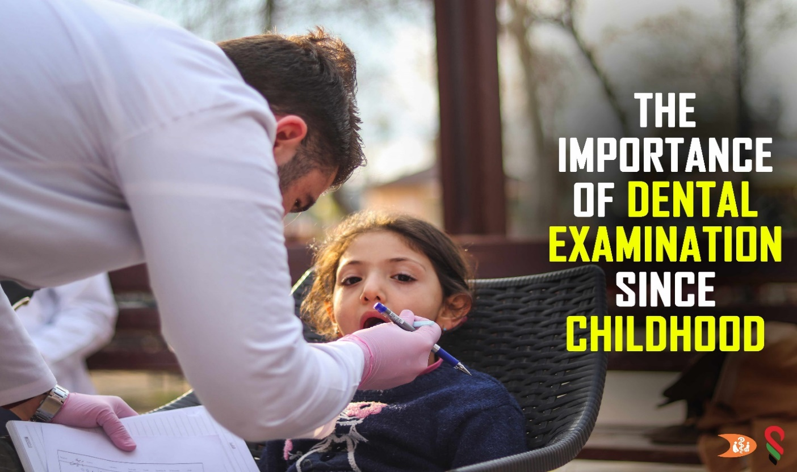
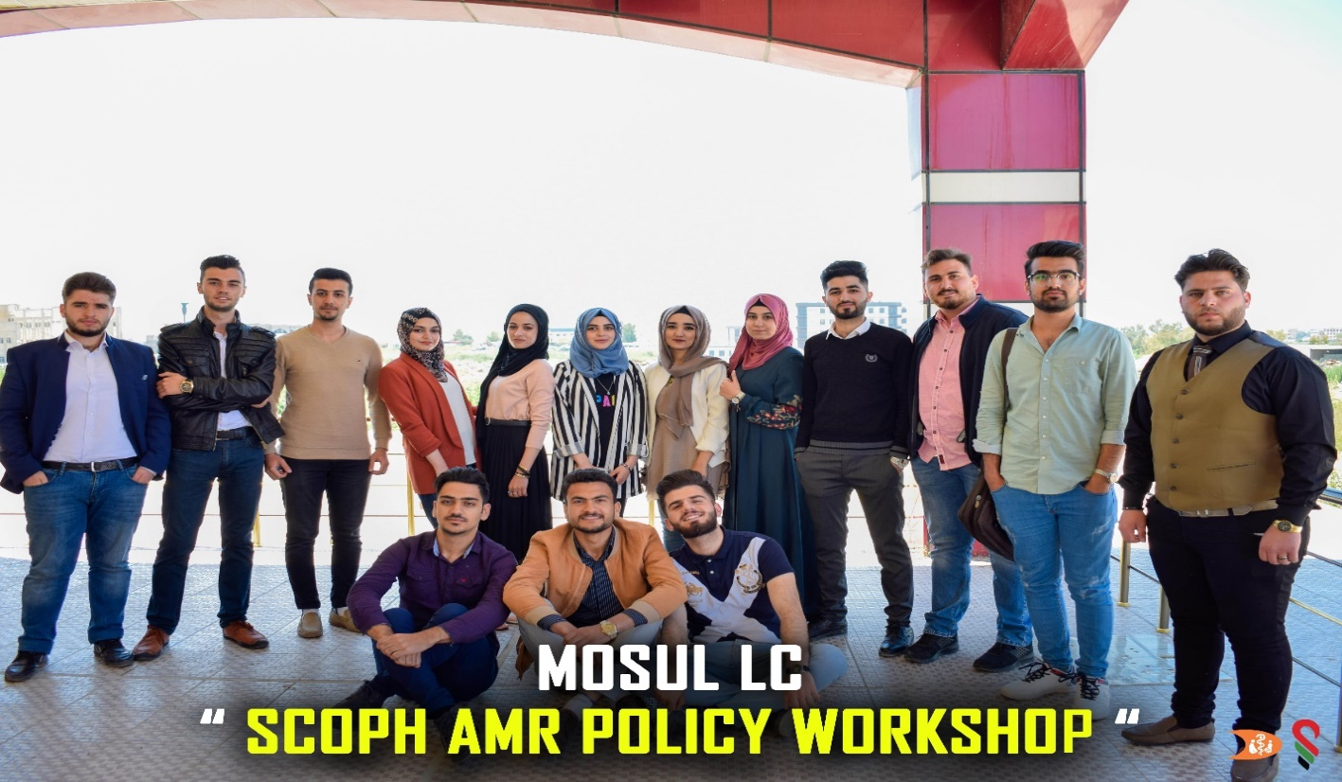
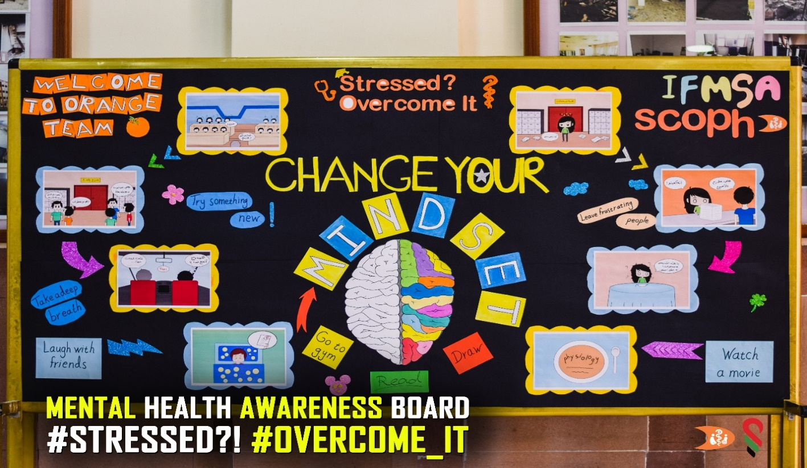
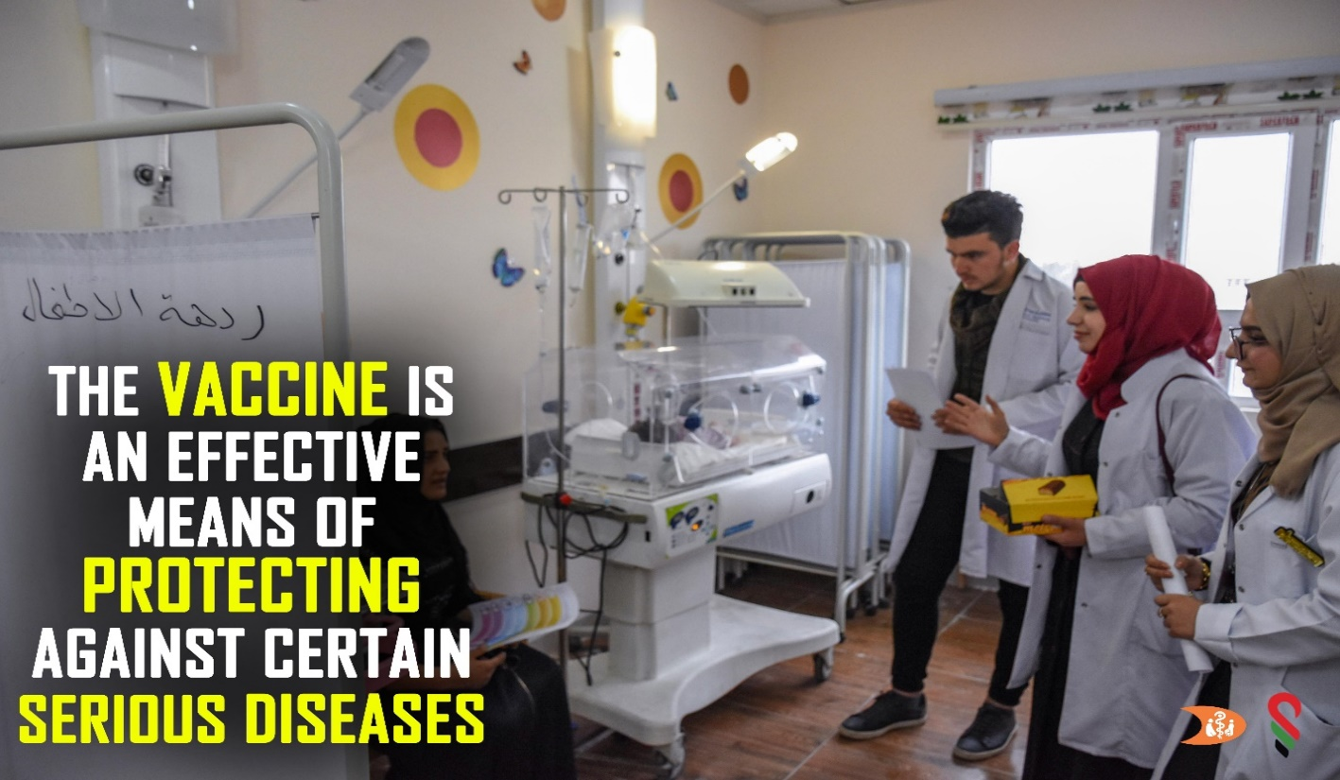

Slide 10
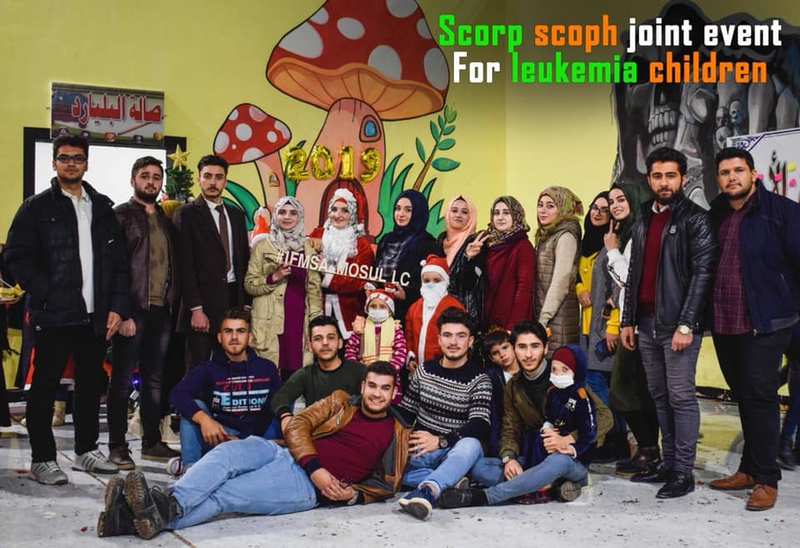
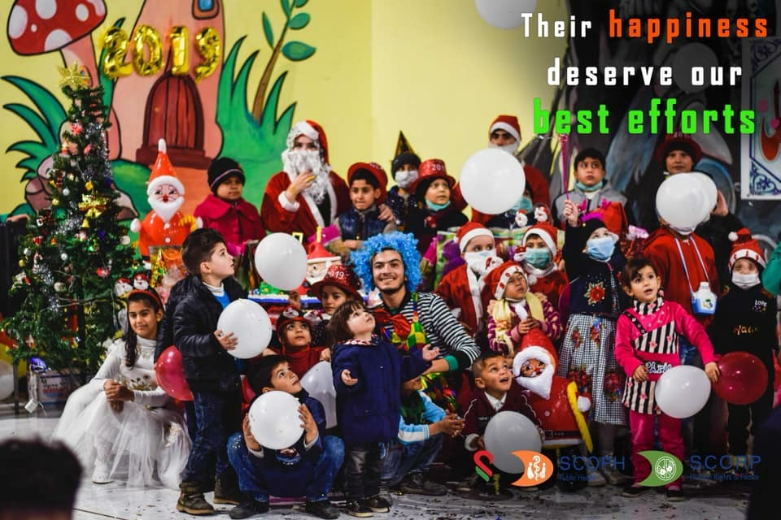
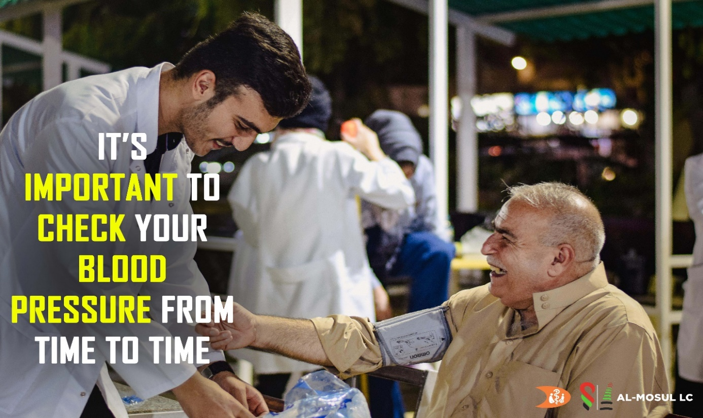
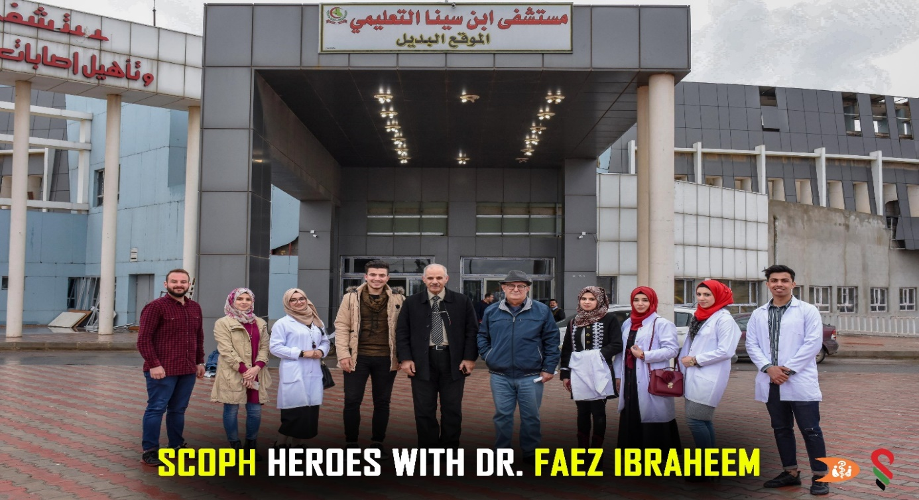

Slide 11
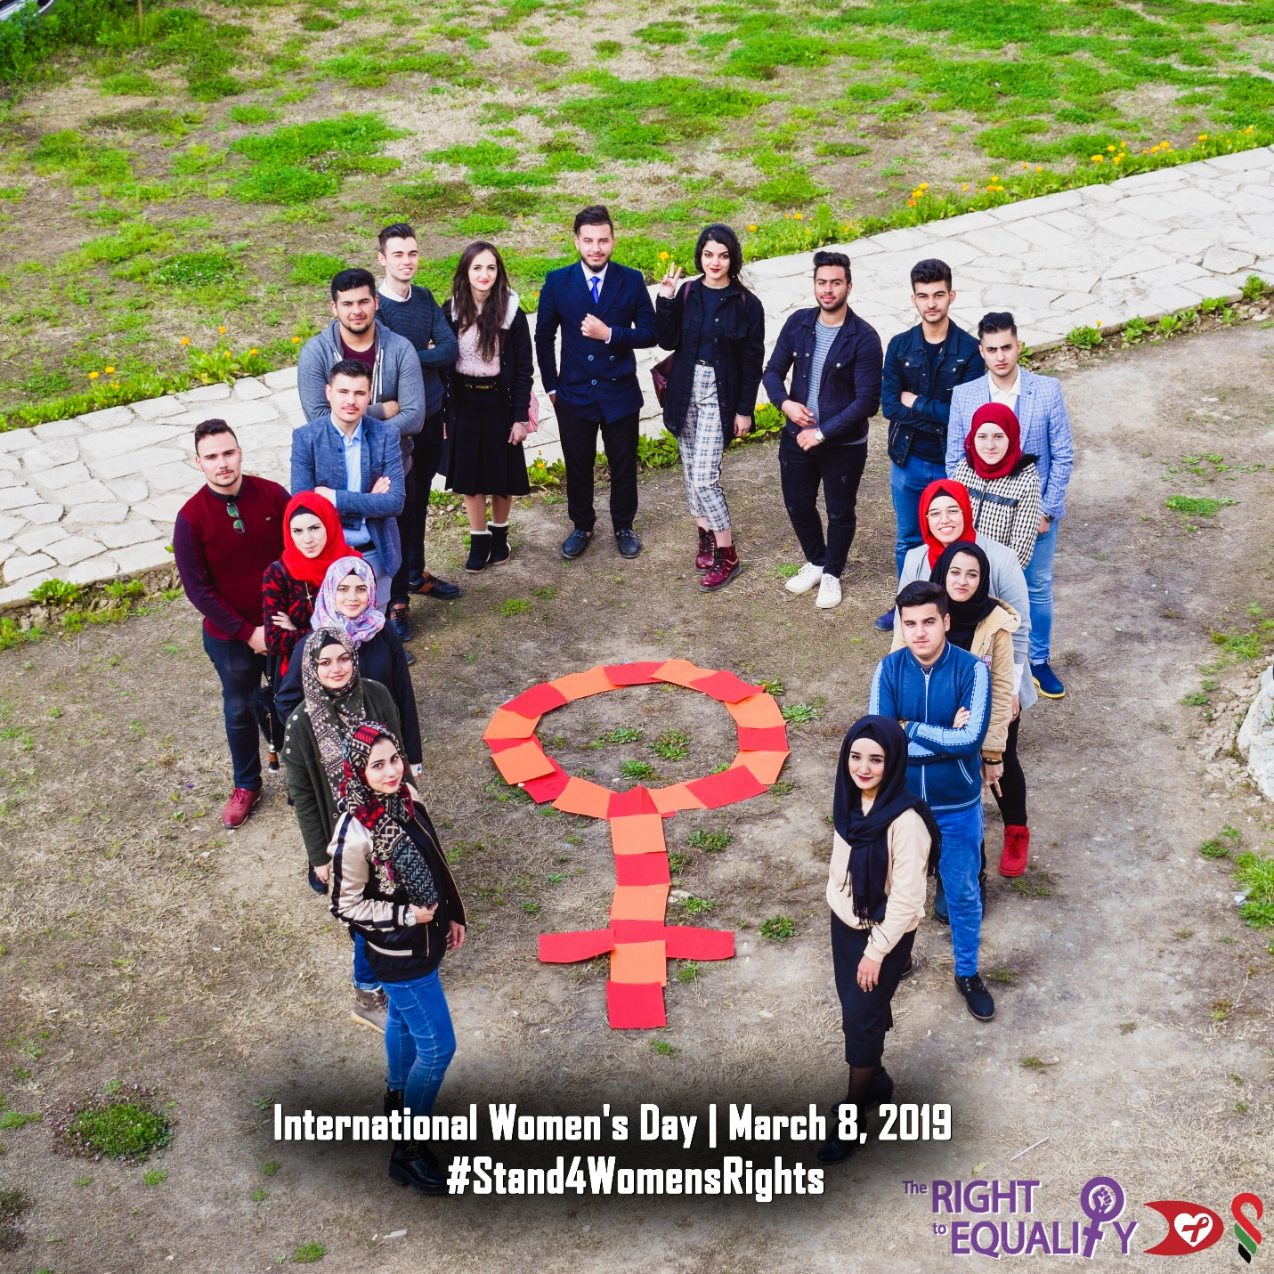

Slide 12
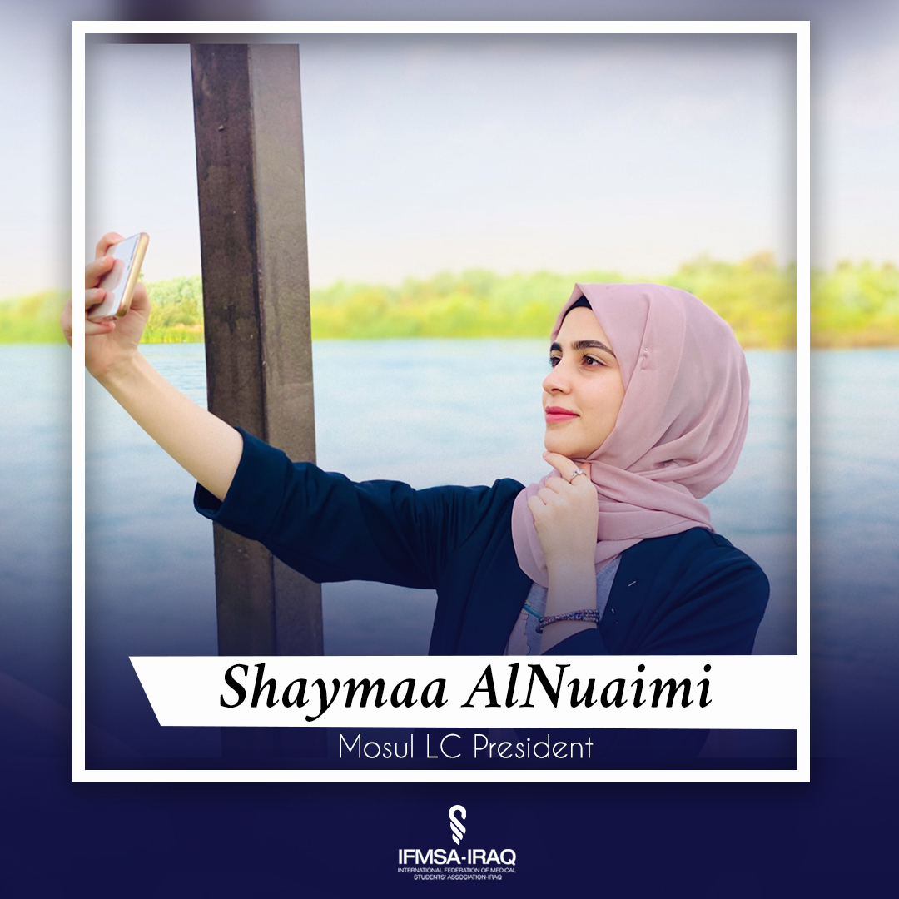
Conclusion of project
I believe that every undergraduate student should improve his/her skills in communication, leadership, team building and design thinking.
This can be done by starting voluntary work in NGOs (Non-Governmental Organizations) after gaining experience and knowledge and building many relationships with his community. Then he/she can choose the most appropriate work for him/her. Whatever the type of work small or big, agricultural or industrial projects, governmental or private sectors, it has the ability to face all difficulties and meet the society needs in that leads to huge financial gain.

