Slide 1
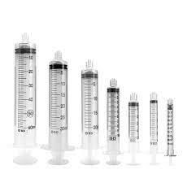
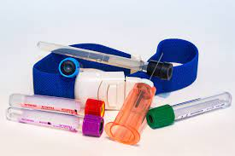
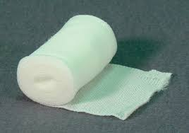
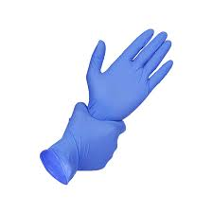
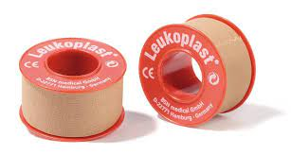
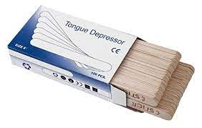
Production of medical requirements
Idea owner: Group members
This project aim to open a small plant to produce simple medical and biological requirements.
Medical requirements can be provided to hospitals, pharmacies, medical labs and for academic researches at university.
This project would make these things more available in hand in cheaper price and reduce the importing.

