Slide 1
Olive Production and Derivatives Cooperative Project Prepared by Basim Esa Abas EC02 team Supervised by Dr. Muhanad Dr. Saraa
Mosul University
Administration and Economics College
Business Management Department

Slide 2
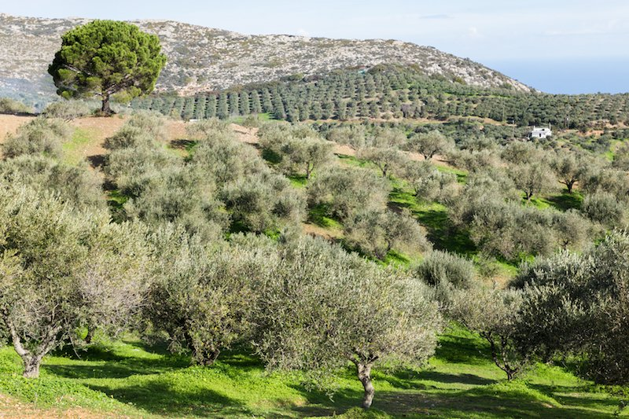
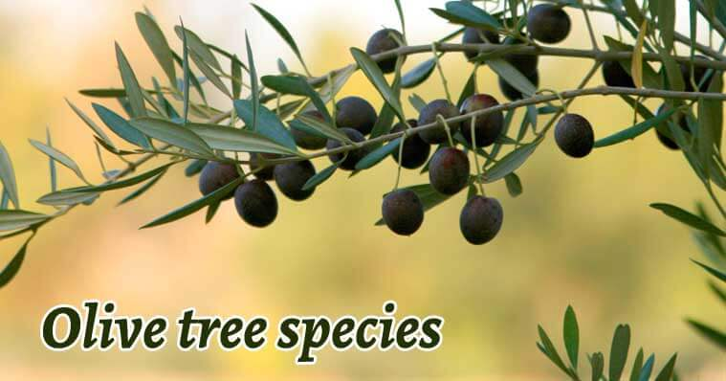
Located in the Bashiqa area of Mosul. Millions of olive trees a large crop of olives is produced annually and the olive crop is known to be guaranteed

Slide 3
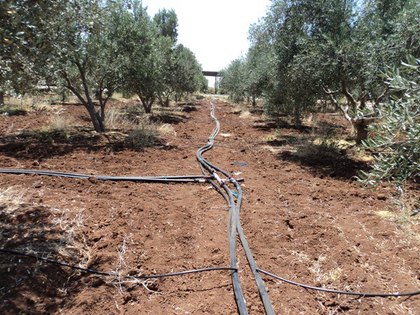
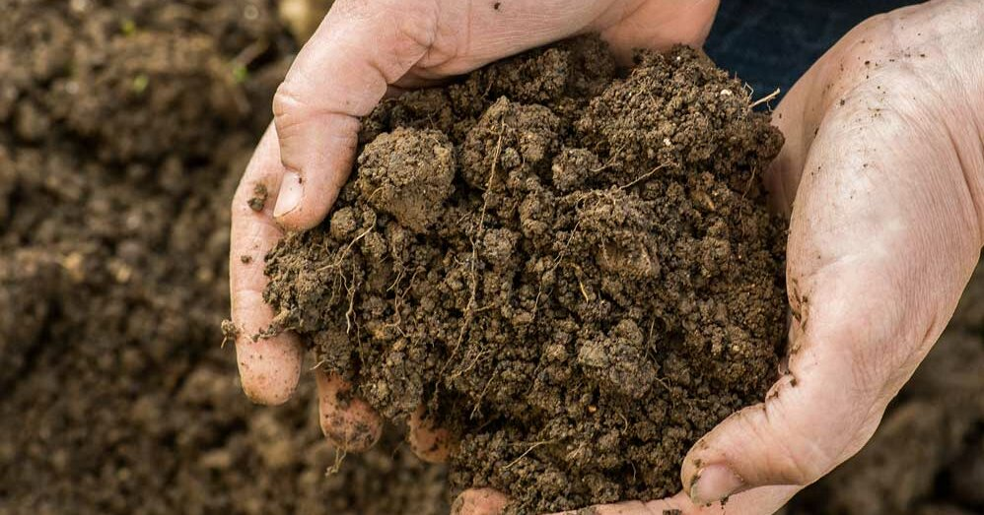
it does not need very fertile agricultural soil or a large amount of water and the land of the region is very large to grow such a crop if we look at the local markets

Slide 4
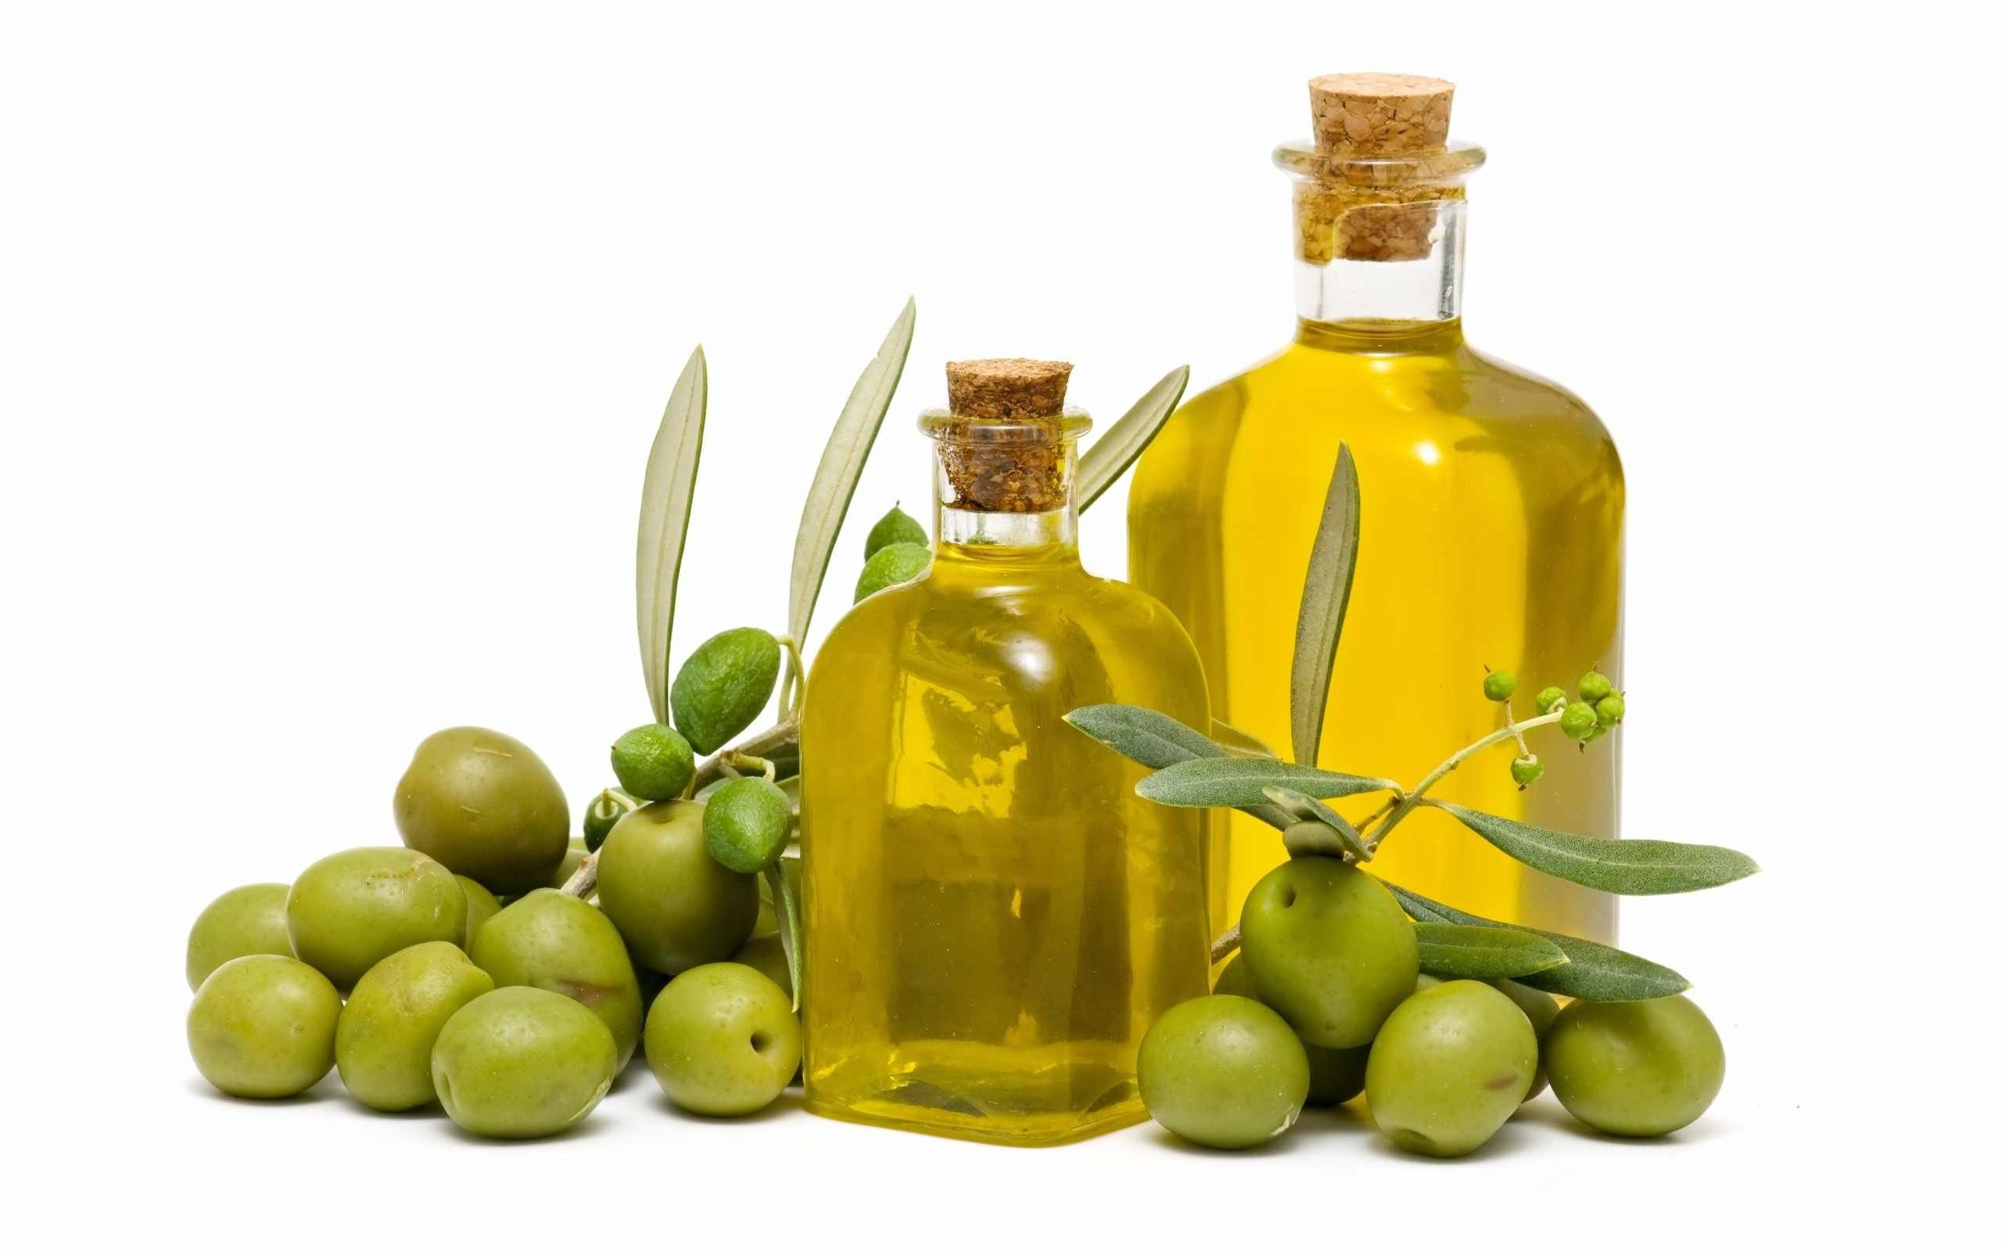
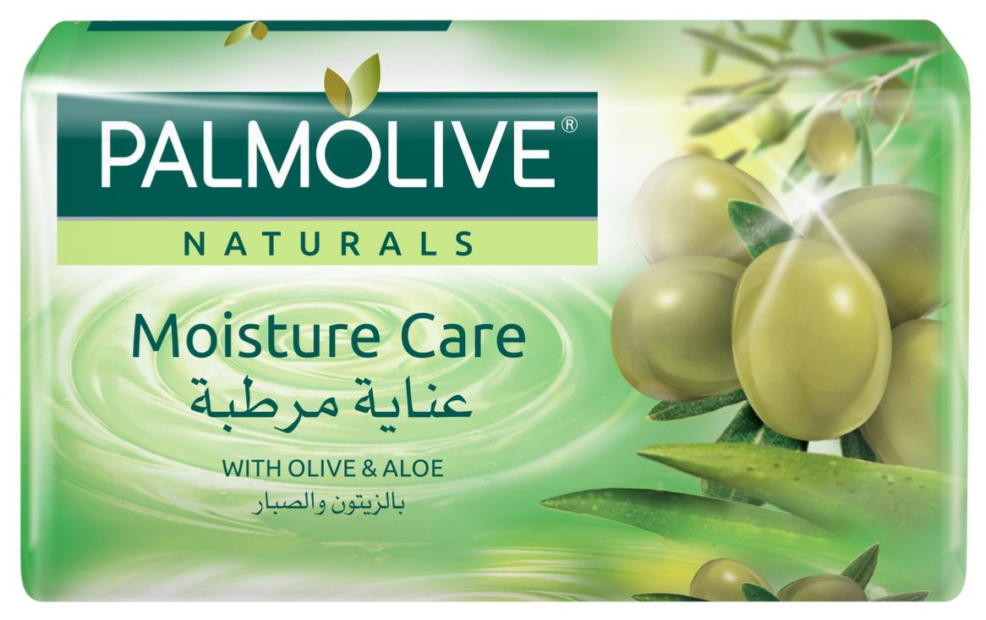
We will find that these markets are full of olive products and derivatives such as olive oil, soap and others in large quantities and at high prices, all imported

Slide 5
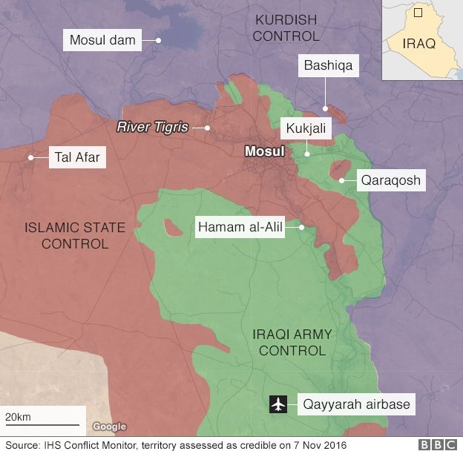
Our proposal is:
Work cooperatives between the owners of these farms because they are owned by individuals with graduates from the faculties of agriculture, management and other specialties by making factories in the same area (Bashiqa and surrounding areas)

Slide 6
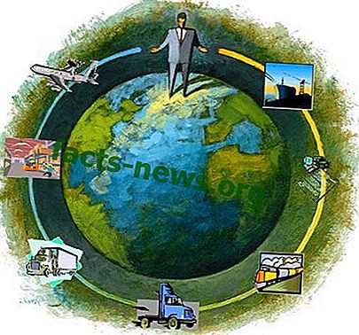
These factories are working to fill olives of all kinds as well as the work of olive oil, factories specialized in the manufacture of olive oil soap and other derivatives these factories cost low and their returns and profits are guaranteed and produced in the best types and international specifications at competitive prices to the domestic market, they reduce and limit imports and can be exportable.

Slide 7
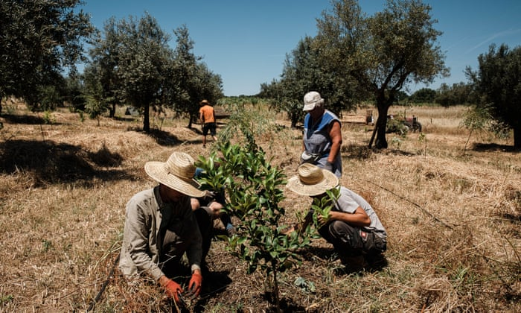
These factories can accommodate large numbers of graduates, technicians, engineers and agricultural workers as well as farmers and farm owners. It will create economic complexes around these factories and is close to Mosul.

Slide 8
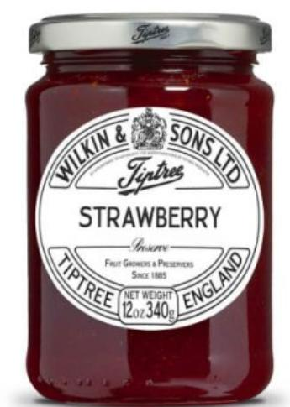
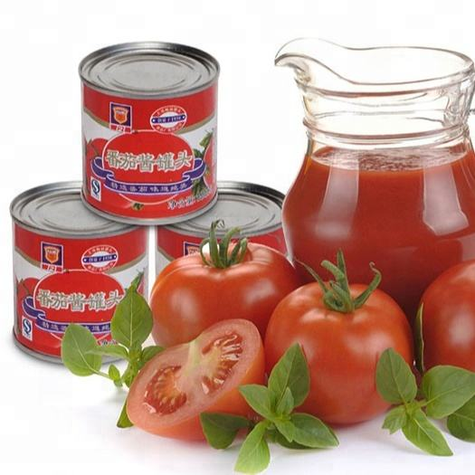
These plants can be expanded with such factories as jams and tomato paste, the main food consumed in Iraq

