Slide 1
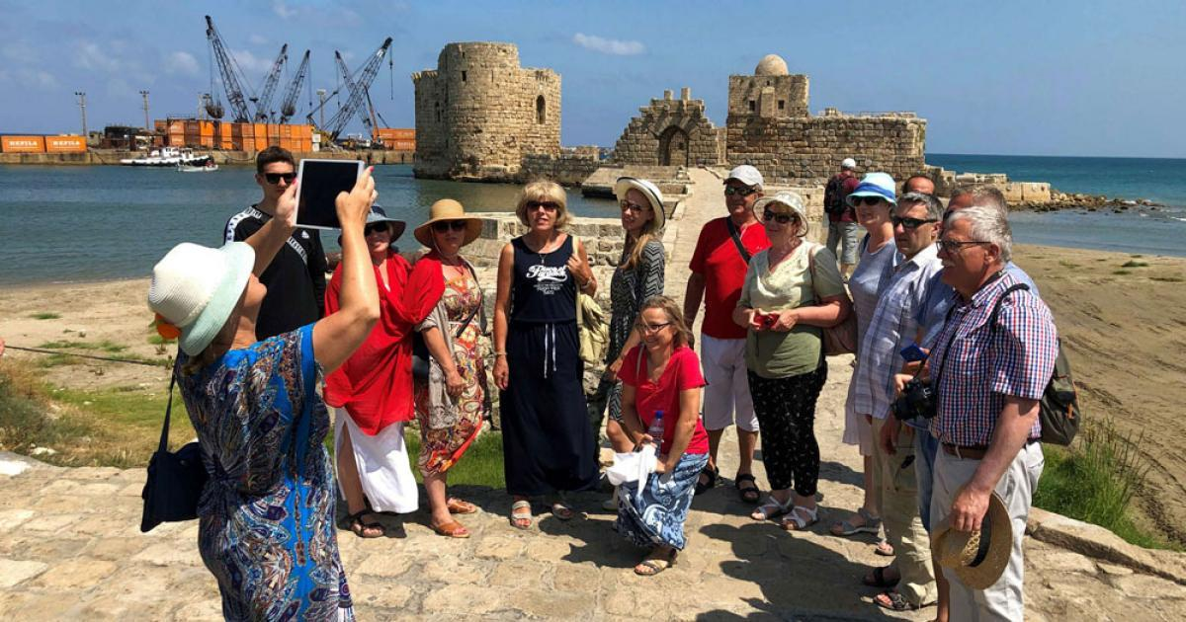
Photography as a clue for tourism
Idea owner: Husam Luay
Husam thinks that every one has a camera or mobile phone documents a cultural landmark or an archaeological place while travelling or trip of discovery.
Sharing those pictures on social media help in attracting
people for tourism in different places and also photographer
can receive special offers in different fields as tour guiding,
photography and media.
This project would help in increasing cities income via tourism and hence many job opportunities can be provided.
Notes:
1

Slide 2
In conclusion:
All of the mentioned ideas are based upon our own situation, circumstances and learning.
All of the mentioned ideas oriented at one goal which is providing job opportunities or what the labour market needs.
Projects mentioned aimed at changing our current reality and creation a new culture for youth to find a job other than government employments.
Projects mentioned inspired youth to create joint ventures among them to increase the speed of completion.

