Slide 1
Let’s reflect on employment crisis in Iraq
19.06.2021
EN05 (1)
Competitions as recruiting opportunities
of University
Mosul
Graz
Tu.Dortmund
Prepared By:
College of Engineering
Architect Department
Juman Wajeeh
Omar Nazar

Slide 2
Story of graduates and students looking for a job
The passion to look for a job after graduation may be let down by not being able to find an opportunity
After the student graduates, he starts looking for a job, but he may not find a job due to lack of experience, so he can be compensated by participating in a meeting to create an opportunity for him in addition to gaining experience

Slide 3
Story of graduates and students looking for a job
But the opportunity may come from a competition when you least expect it

Slide 4
Story of graduates and students looking for a job
The new experience may lead to fear and tension, due to strong competitors

Slide 5
Story of graduates and students looking for a job
maybe fate changes and you become the first

Slide 6
Story of graduates and students looking for a job
Other ranks have another destiny and a second chance

Slide 7
Story of graduates and students looking for a job
You should be careful of thieves
As for the second ranks, it is possible to provide an opportunity for them by presenting their work after the end of the competition on the communication platforms, with caution against the possibility of the project being stolen.

Slide 8
Story of graduates and students looking for a job
By presenting your project intelligently and wisely
The solution to this problem is to present the project in an interesting way, only after purchase it can be viewed in full, thus preserving the right of the designer and the buyer.

Slide 9
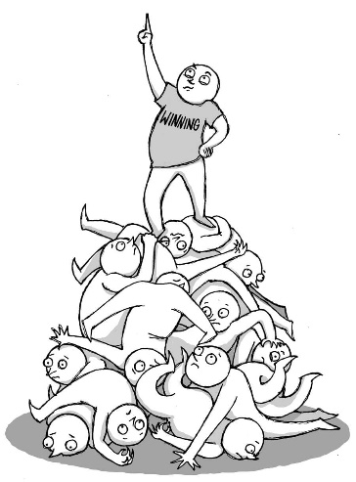
Advantage and disadvantage
the competition made in good timing
the competition in bad timing
long list to do in short timing
short list to do in short timing
the number of applicants for the competition is limited
the number of applicants for the competition is large

Slide 10
Titles of competitions that include different disciplines:
_Sustainable packaging design competition with cash prizes of 6200 euros
_An essay competition for school students from the Ayn Rand Institute, with a prize money of $2000
_Google competition for web developers and a chance to win a funded trip to the company's headquarters in America
_A short story writing competition from the State University of Arizona, with a cash prize of $1,000
_Scroll of Honor competition in the field of sustainable human development
_Mathematics and Computer Science Conference competition for young researchers in Germany
_Contest for designers from the charette platform in the field of urban design
_Photocrowd photography competition entitled garden photography Filmmaking competition at the Independent Star Film Festival in Munich
_Berkeley International Prize
_Rifaat Chadirji Award
_Aga Khan Award for Architecture
student's competition
Universities plays a major role in providing students with the experience to deal with competitions through holding workshops and competitions that take place in them.

Slide 11
Finally:

Slide 12
Thanks for listening

