Slide 1
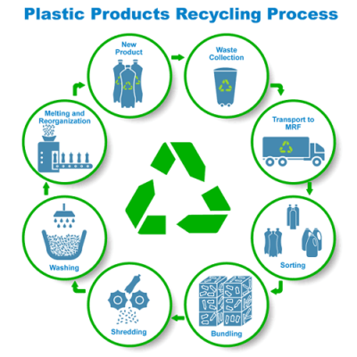
Recycling water bottles and plastic cans prepared from polyethylene Terephthalate (PET)
Idea owner: Group members
This project aim to reuse domestic, commercial and industrial plastic waste, as it is used as starting materials in other new products which have a good quality and may be different from the original one.
Products can be prepared: spare parts of cars, packaging bags, construction materials, tennis balls, clothes, plates, hangers, etc.

Slide 2
If its impossible to clean the plastic completely and remove the contaminates from it, in this case, it can be recycled thermally via combustion and using as a source of energy.
The importance of this project lie in:
Reducing the depletion of resources and achieving sustainable development by securing starting materials from exploitation of waste instead of raw materials.
It also has an important role from an environment point of view by protecting air and water from pollutants, as they are collected and reused instead of burning that pollutes the air or landfills that pollute groundwater.
In the economy by reducing the areas needed to dispose of waste and exploiting these areas for agricultural purposes and to secure job opportunities.

