Slide 1
Mosul is more beautiful
in my lens
Kawthar Ayoub Zebar
College of Islamic Sciences
ED03
Dr. Maan Dr. Hiba

Slide 2
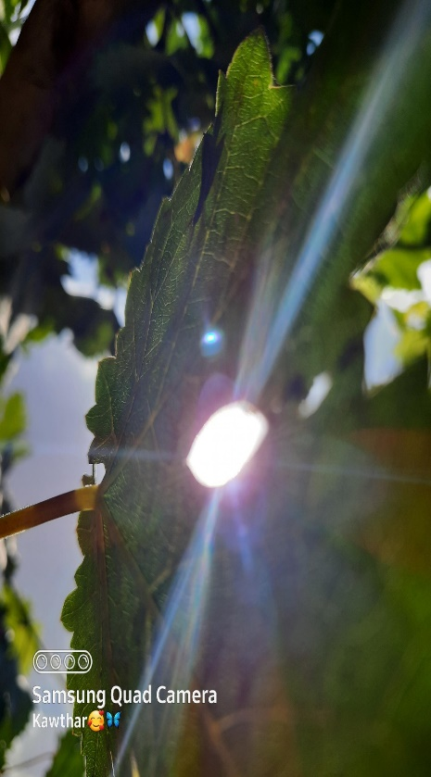
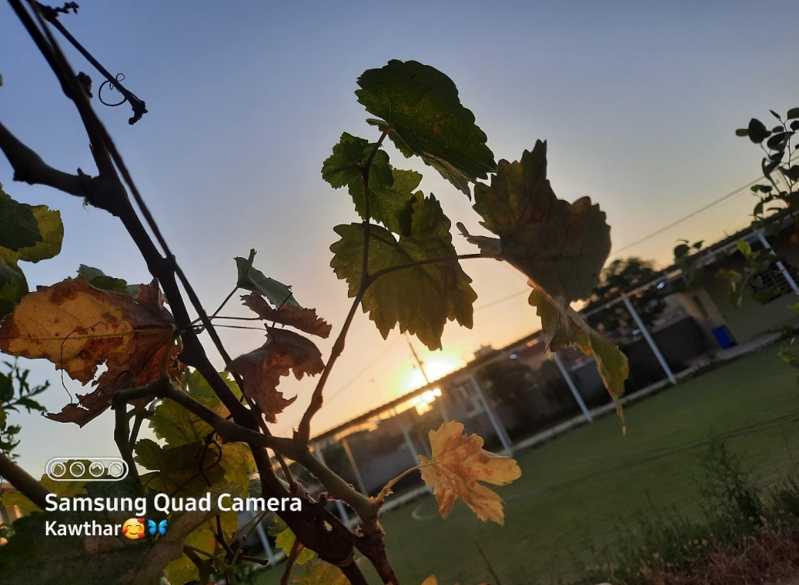
PHOTOGRAPHY
Photography can be a great way to earn some extra money budding Photography can license their work online by creating accounts on social media on photo sharing platforms or they can make photo prints and use them on greeting cards, posters or note cards combine with a catchy story poem or other piece of prose to go along with the picture

Slide 3
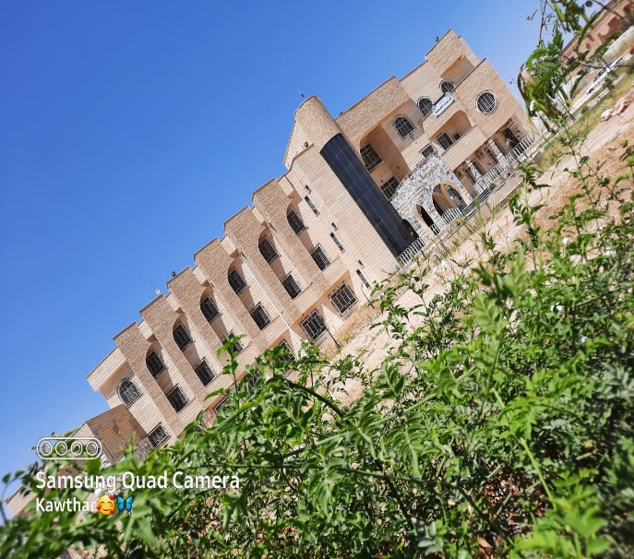
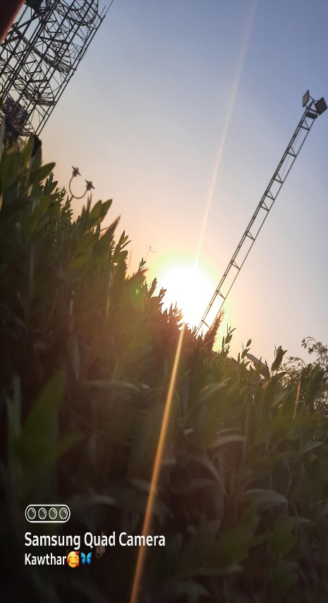
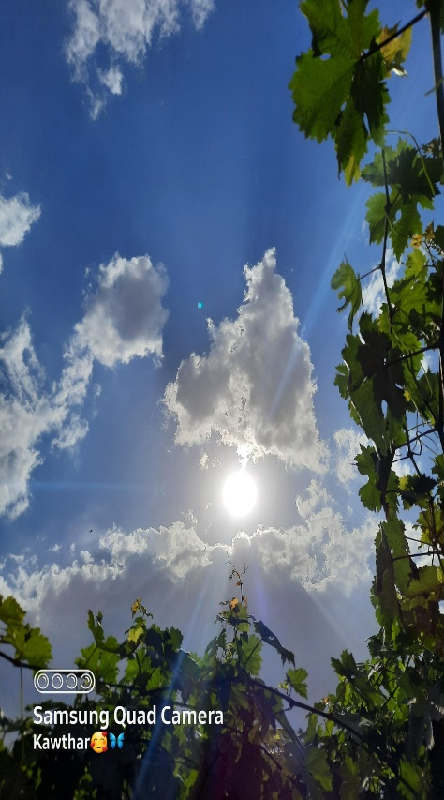
Project
requirements
The requirements that the project needs are not many, it may only need to buy a modern, high-quality camera, and it can be purchased second-hand from someone if there is no ability to buy it new, and the project also needs a computer or laptop with high capabilities that includes the design programs used in the modification process on the pictures

Slide 4
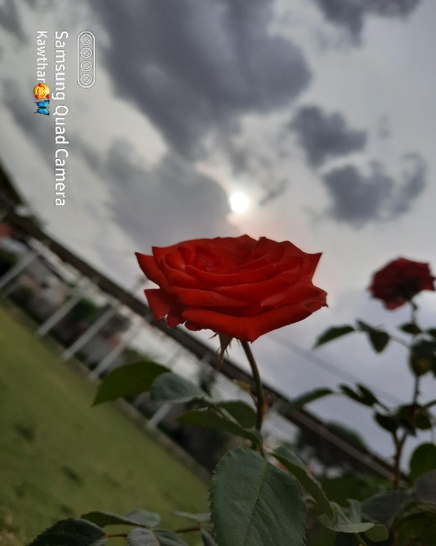
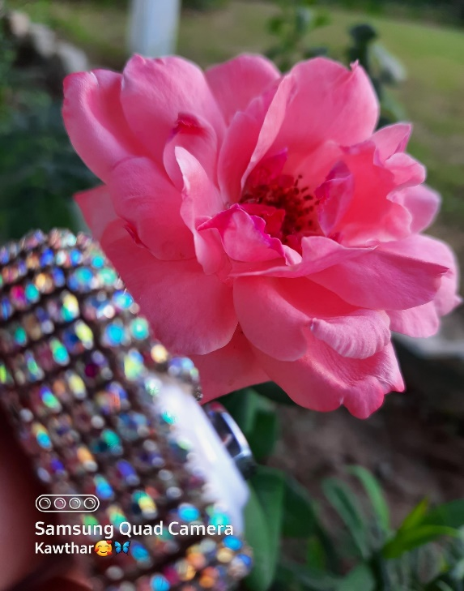
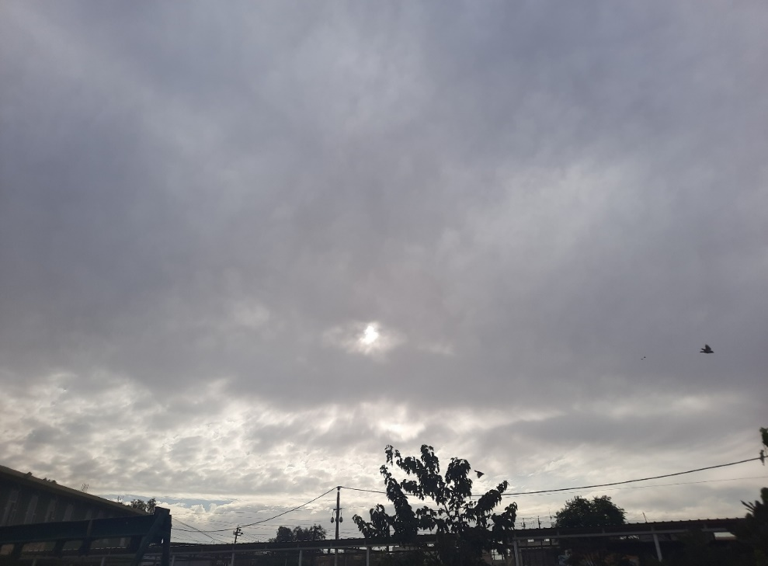
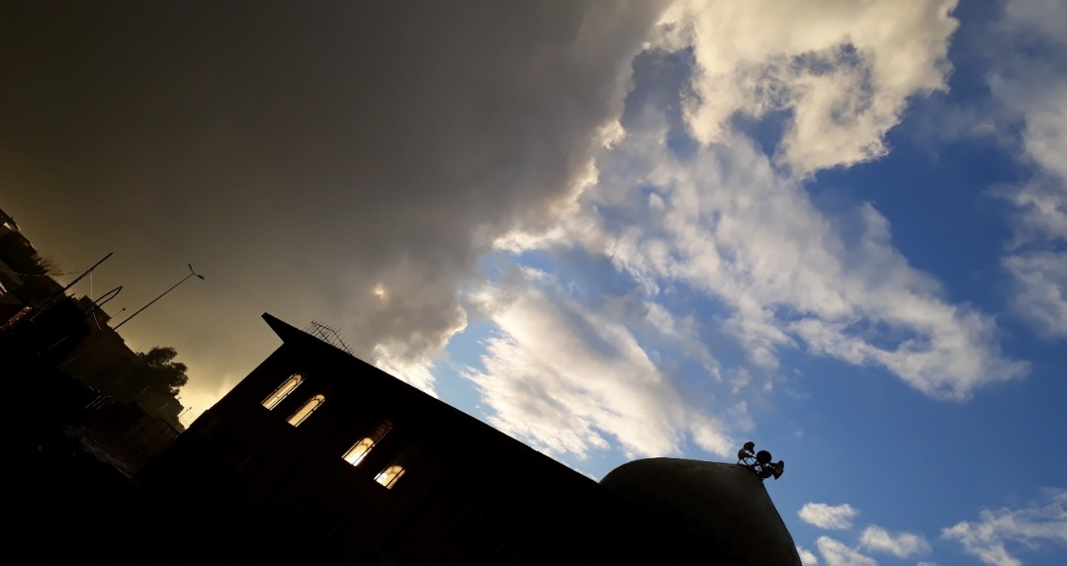

Slide 5
Project Conclusion
I will continue to develop my hobby in photography until I deliver my photos to the whole world and make my photos express beauty, heritage, love, happiness, fear, injustice and freedom, and my photos will be a message to all human beings that express all the meanings of life.

