Slide 1
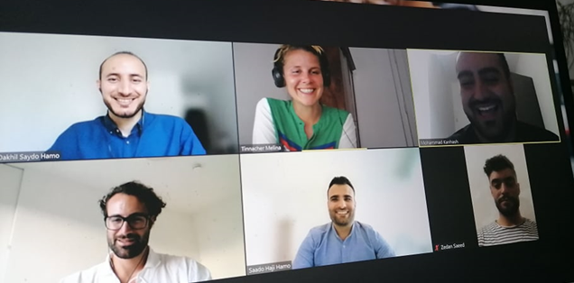
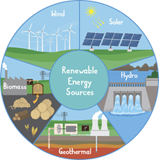
Renewable Energy in Iraq H05
Zedan Saeed, Dakhil Saydo Hamo, Saado Haji Hamo, Mohammad Kanesh, Jan Schmidt Jeschek, Melina Tinnacher

Slide 2
SOLAR
POWER
Solar power is energy from the sun that is converted into thermal or electrical energy.
Solar energy is the cleanest and most abundant renewable energy source available.
It has a variety of uses, including generating electricity, providing light or a comfortable interior environment, and heating water for domestic, commercial, or industrial use.
There are three main ways to harness solar energy:
photovoltaic, solar heating & cooling, and concentrating solar power.

Slide 3
ELECTRICITY PROBLEMS IN IRAQ
Until the end of the eighties, Iraq was on the top of being a developed country in the Middle east, however this situation didn't last for so long.
After the Gulf war in 1991; Iraqis managed to rebuild what they could, and Iraq produced around 50 % of its need from electricity.
Notes:
On 24 of Feb. 1991 the world lead by USA Operation "Desert storm" to liberate Kuwait from the Saddam's invasion. In which Iraq paid still paying a very expensive price of souls and money, one side of that war was destroying every single Electricity Station all over Iraqi soil.

Slide 4
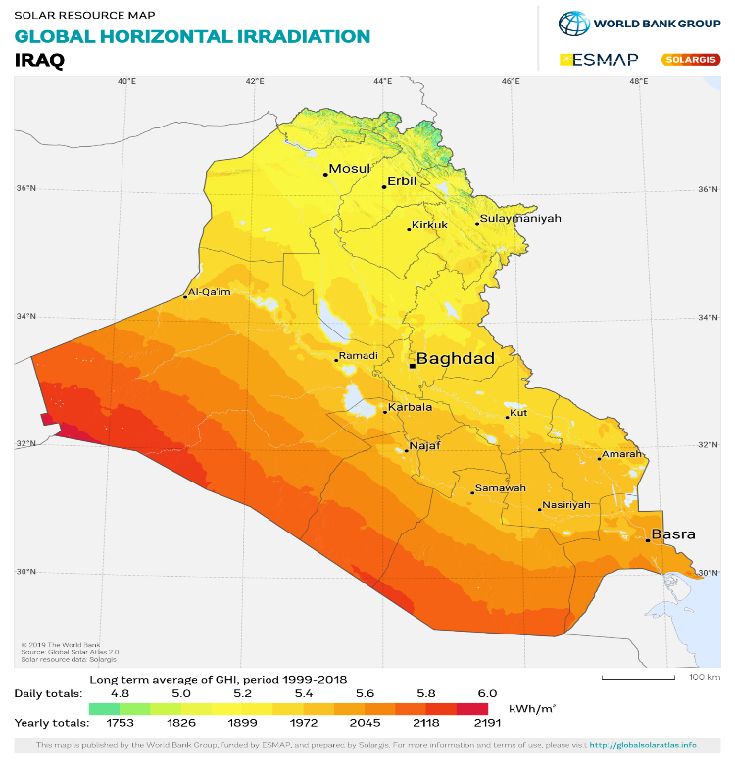
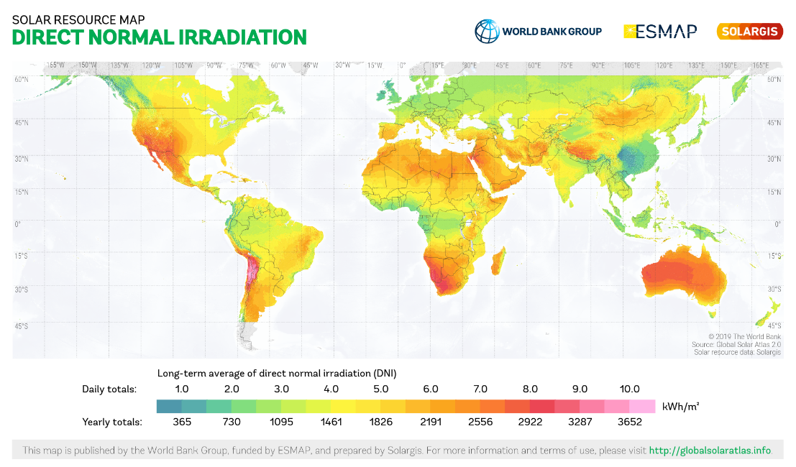
WHY SOLAR ENERGY? IN IRAQ
As shown from the map, Iraq is among the richest countries in the world with direct normal irradiation due to its location. So, this gives Iraq great potential to utilize solar energy.
Source: https://solargis.com/maps-and-gis-data/download/iraq
Notes:
Solar energy has not been sufficiently used currently in Iraq. But, this energy source can play an important role in energy generation in Iraq, as the global solar radiation ranging from 2000 kWh/m2 to a 2500 kWh/m2 annual daily average. (Al-Kayiem and Mohammad 2019).

Slide 5
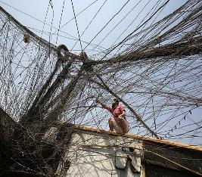
WHY SOLAR ENERGY? IN IRAQ
Iraq spent around 40 to 50 billion dollars for electricity. Without any improvement reversely it got worse specially there are Mafia at the ministry of Electricity in Baghdad, which makes sure that the problem must go on.
The average annual amount of sun hours in Iraq is 3250.0 hours, about 200 hours between Nov till Apr, and reaches 350 between May and end of Sep.
This amount of annual Sun hours makes Iraq one of those countries, which can use the sun to provide its population with clean electricity.
https://www.baghdad.climatemps.com/sunlight.php
Notes:
With the American Invasion 2003 and what followed it from sectarian war, war against Al-Qaeda, and the powerful force of corrupted Politicians (whose are lead Iraq at moment).

Slide 6
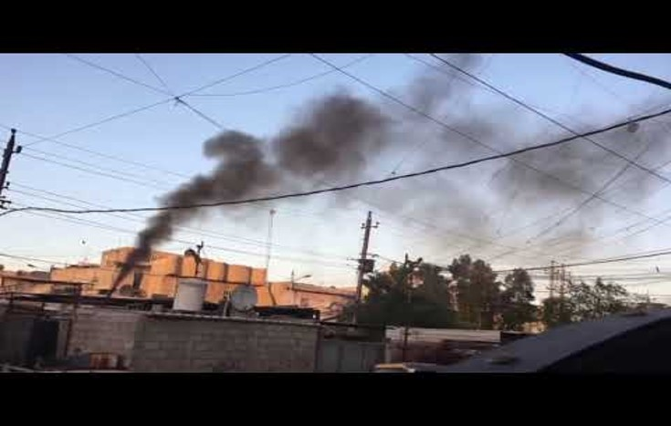
PRIVATE GENERATOR IN IRAQ
The generator causes various kinds of pollution on the environment and human health, for instance, noise, Co2, and visual noise from cable, overlapped wires, and smokes.
http://www.youtube.com/watch?v=J9mej6-R3uA

Slide 7
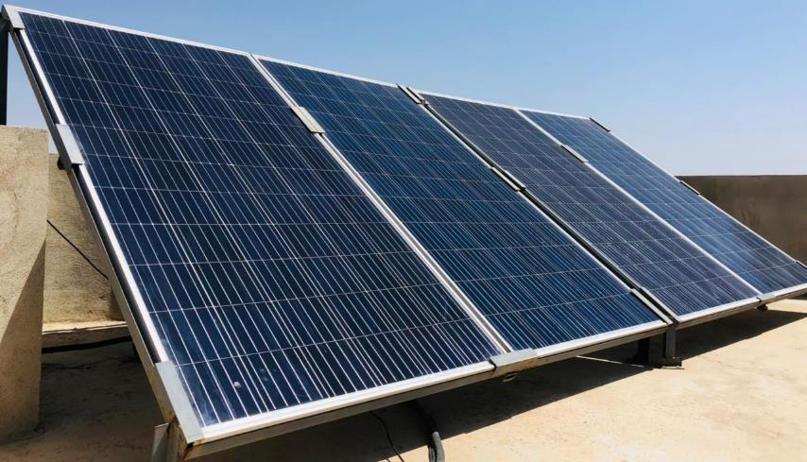
EXAMPLE
A household from Shingal installed the PV on their own. with the following specifications:
3KVA system, this type of panel is 450 W, and its cost is around 150$, each.
Four solar panel (1*2 m ) connected together(as you can see them in the picture).
Inverter, from DC to AC, cost between 320$ -350$.
Batteries cost starting from 100$ for each.
The total cost was around 1500 $. In general, the cost of panels are depending on the type and surface area of the panel.
polycrystalline panels
The angel of locate is between 34°45’ in Iraq.

Slide 8
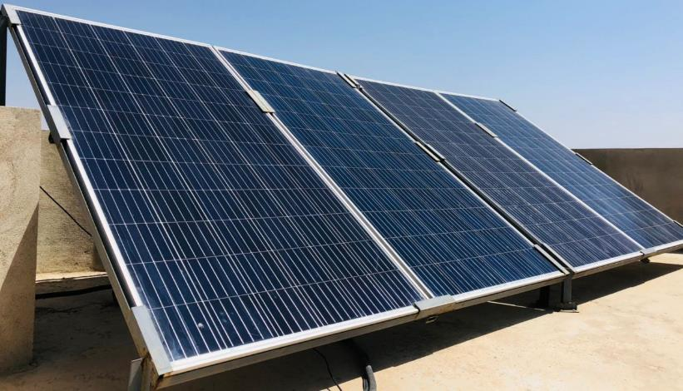
EXAMPLE (CONT.)…
Weaknesses and Strengths using solar panel in Shingal or in Iraq in general.
Strength point:
Reduces electricity bills
Low maintenance costs
Average sunlight 8.48 hours/day
The system produces about 6 amps (1.32 kW)
From the system the house is supplied with electricity between 19 to 24 hours a day.
Comfortable and eco-friendly
Renewable energy source
Weaknesses:
Expensive to buy
No support from Iraqi government or organization
Poor people cannot afford the experiences to buy it
The panels needs to be cleaned with something smooth every two week at least ones
Uses a lot of spaces
Weather dependent

Slide 9
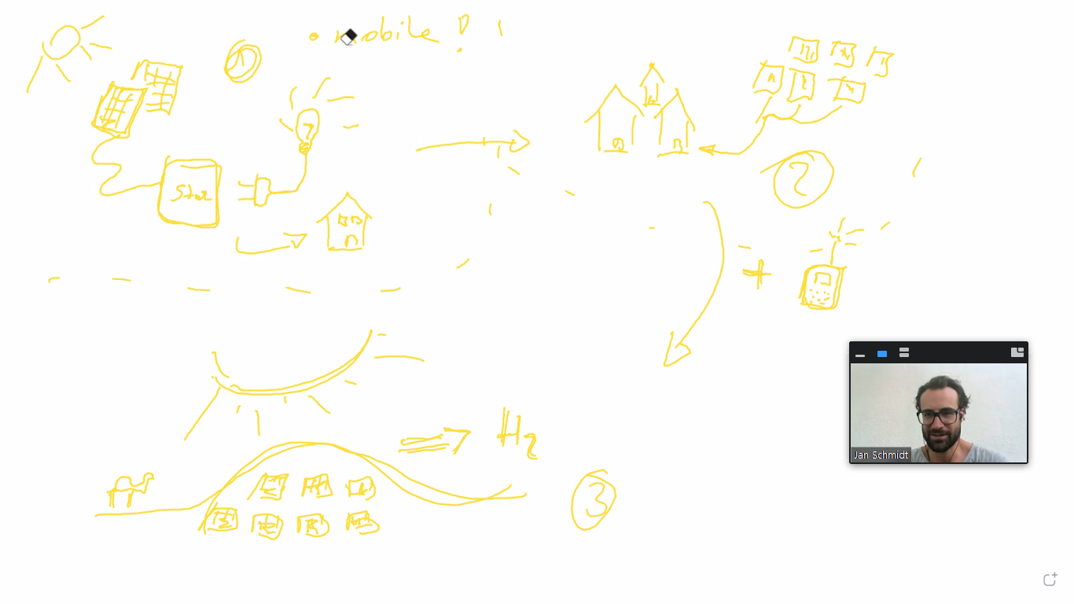
SAVE
ELECTRICITY
Harvesting solar energy for example in the desert→ hydrogen→ exporting → reducing unemployment→ increasing economy→ life quality will increase

Slide 10
THANK YOU AND STAY SAFE

