Slide 1
A website that supports dental students
in their future work
Maryam Nabeel
AL-Hadbaa university –Dentistry college
ED03
Dr. Maan Dr. Hiba

Slide 2
Aim of project
This site helps to provide advice to students studying in the field of dentistry, as well as through this site I promote some of the necessary medical materials that the dentist needs This site includes pages to connect with people to provide advice related to dentistry

Slide 3
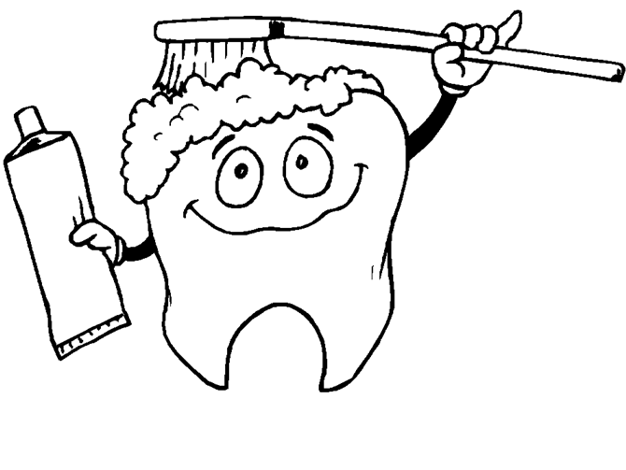
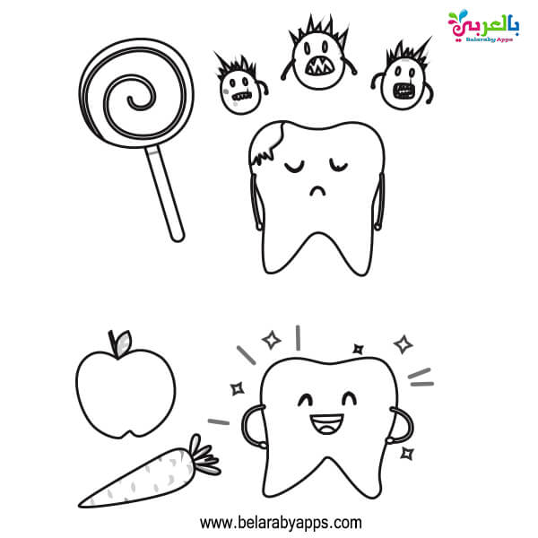
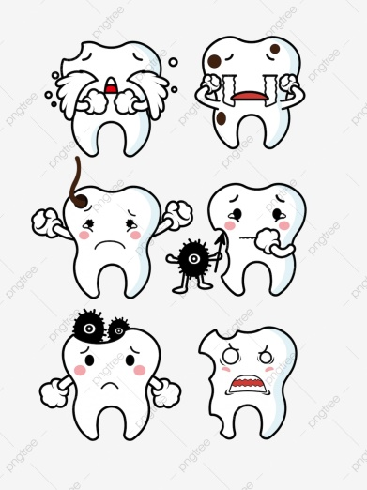
Websites help reduce unemployment
The social media one of the great facility should be used, especially in the working. It has the ability to connect people to each other despite the distance.
For example, in dentistry:
we use a page on the Instagram program, for example, and this page presents tips about dentistry, its objectives, features, proper awareness for people to maintain the health of their teeth and how to take care of them.

Slide 4
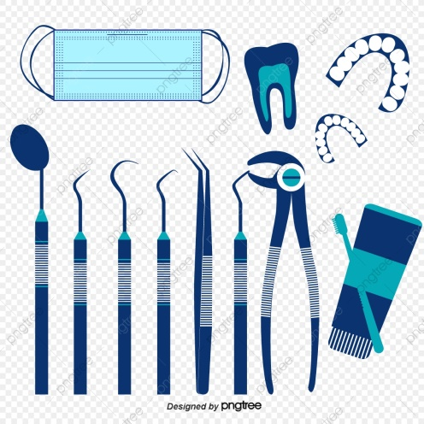
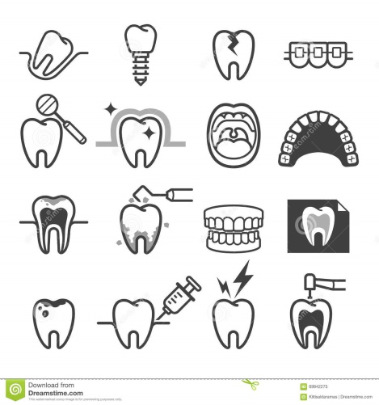
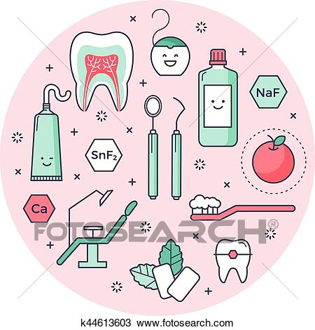
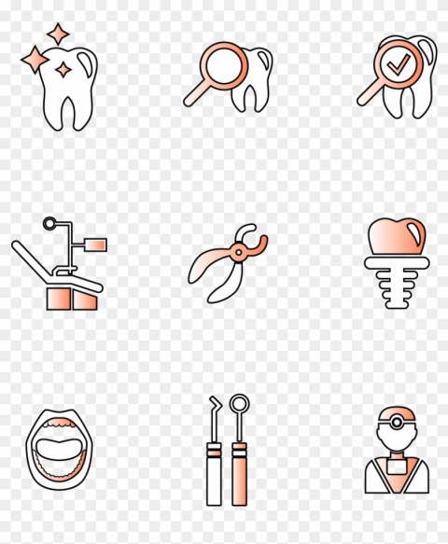
Promotion of dental materials, tools and equipment
One of the good means of profit is to search for the source of the goods, i.e. the main trader, and on the other hand, to reach the beneficiary of this goods or service, and this applies to dentistry. For example, materials for fillings, dental materials used in industry, orthodontics, an explanation of their types and best and the results of each. Of course, this provides a good income of money in addition to continuous communication with serious materials and devices that enter the dental work market

Slide 5
Communication with scientific societies and conferences
Social networking sites will make us a wide field and great fame, and this will lead to our fame and the cases we work in and benefit us in forming friendships that lead to opening great opportunities in the future for us in terms of career.
Participation in a group of scientific conferences that increase the person’s scientific level and give a lecture in it, make a group of scientific courses that benefit students, as well as join student volunteer organizations. This will work to develop abilities and skills and open up great horizons for the person
for example, joining to the Iraqi Dental Student Association (IDSA) is one of the most important organizations to which a dental student can be organized, as it works on scientific material and participates in a group of lectures with dentists from all the Arab world, and provides the opportunity for cultural exchange programs

Slide 6
Conclusion of project
It is very important to build a special website for the dental student in order to document his information in this science as well as be a starting point for communicating with the beneficiaries of this science. He will find himself ready to work once he graduates. Trading in supplies and materials for this science will be easier if the person has a specialization in it We do not forget the necessity of global communication in this science through conferences and associations to achieve the spread and knowledge necessary for the success of any work

