Slide 1
Graphic Design
Web site
Ibraheem abdulfatah
Ninevah university –Electronics engineering
ED03
Dr. Maan Dr. Hiba

Slide 2
During my studies at the College of Engineering, I learned from many people that it was difficult to get a government job, so I decided to work in the field of design Therefore, I created a page on Facebook and Instagram for the purpose of providing my services in the field of designs of various kinds as
Designed by LOCO | صمم لوكو
design a brochure | صمم بورشور
Book and magazine design | صمم كتب ومجلات
Advertise Design | تصميم اعلان
Social media ads | صمم صور اعلان سوشيال ميديا
design business card | صمم بزنز كارت
design video editing | مونتاج فيديوات
Edit photos of colors and more | تعديل الصور من الالوان وغيرها

Slide 3
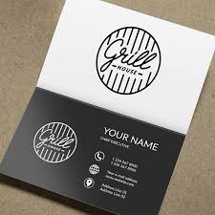
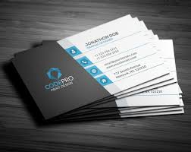
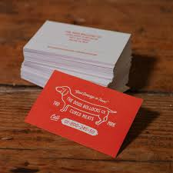
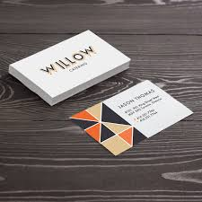
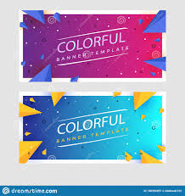
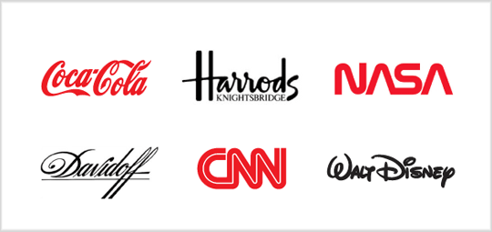
Logotypes
Logos are the cornerstone of every company or organization. Usually it is the job of marketing or PR guys to work with them on a daily basis. Often it’s their job to create them too.
A good logo must be appropriate, it must precisely reflect the company that stands behind it. Another common advice when it comes to logo design is to follow the ‘Keep It Simple, Stupid’ (KISS) principle. If you look at the major brands’ logotypes, you will see that most of them are clean and understandable. Vectr is a free tool that allows you to create and download vector graphics, including logotypes. Getting started with Vectr is extremely easy, and you can turn any stock icon with a little text into a spacious logo.
Business Cards
Someone said that a business card is your professional face. You want your face to look good, right? But creating business cards is usually an everyday activity: a new manager is hired, so you get the task to edit some business card template. Or even create a new one. What do you do about it then?
Business cards can be easily created using any vector graphics editor. Just set up the right size for your project, which is usually 1050 x 600 pixels, or 3.5 inches by 2 inches. Hongkiat has put up together some great advice on business cards design.
Banners
Banners, just like social media covers, are very common graphic design pieces that marketing and PR professionals are dealing with. Whether it’s ad banners or the ones you want to print—follow several simple rules while designing them and you will surely be fine.

Slide 4
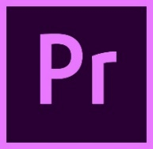
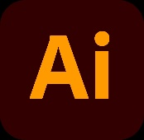
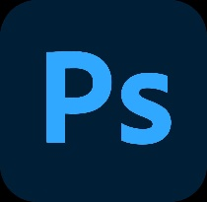
training phase now I am proficient in working on the following programs that help me in designs such as
Adobe premiere
برنامج للمونتاج
Adobe illustrator
برنامج خاص بتصميم اللوكو
Adobe indesign
برنامج تصيم الكتب و مجلات
Adobe photoshop
برنامج خاص بتصميم الصور

Slide 5
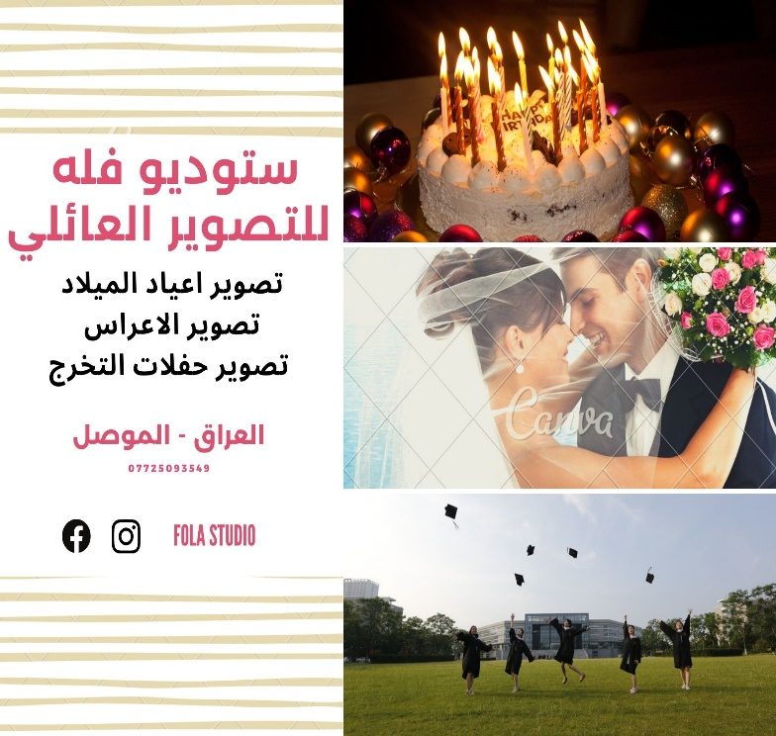
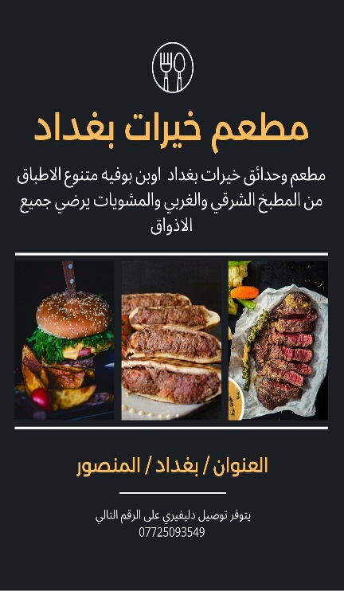
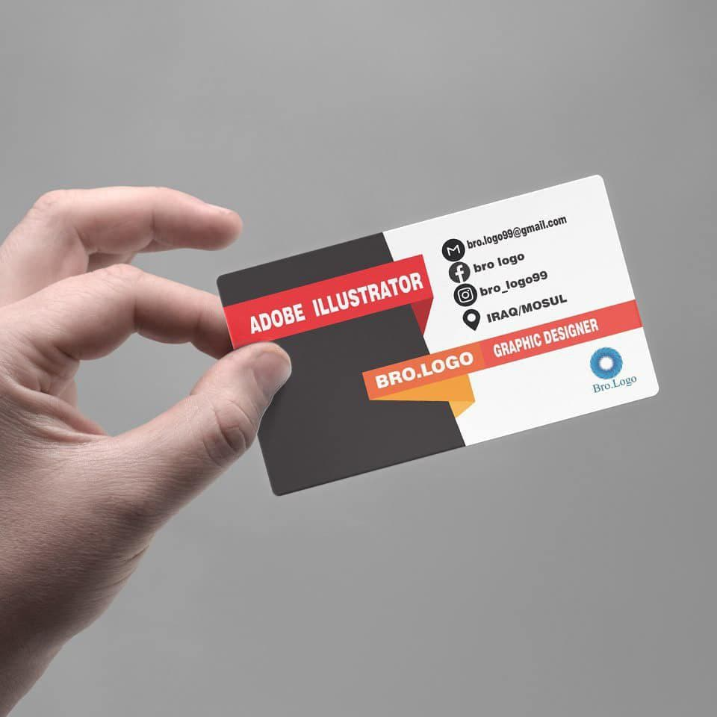
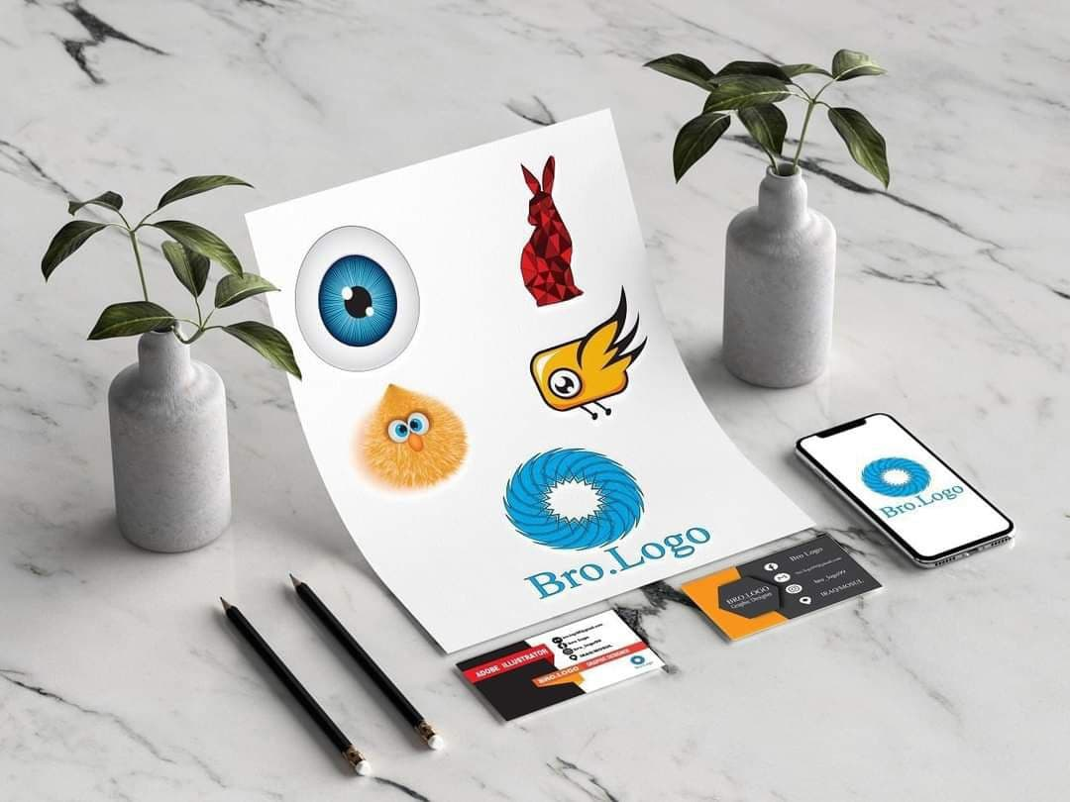
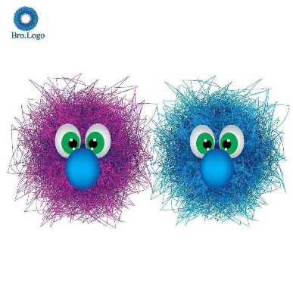
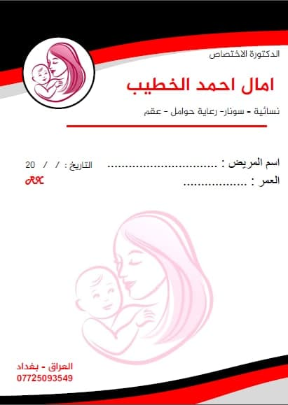
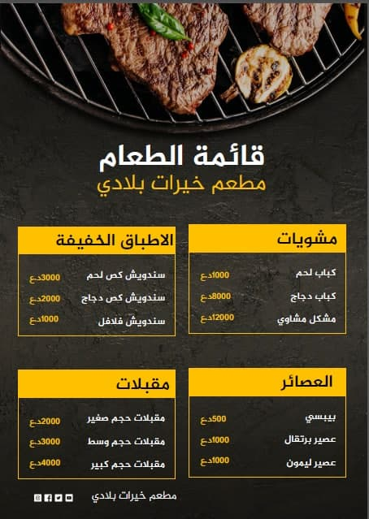
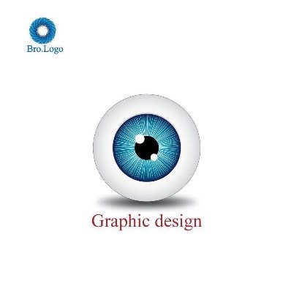
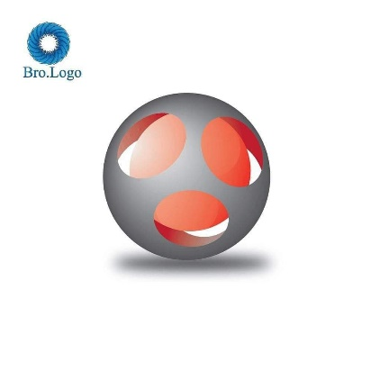
Sample of my designs

Slide 6
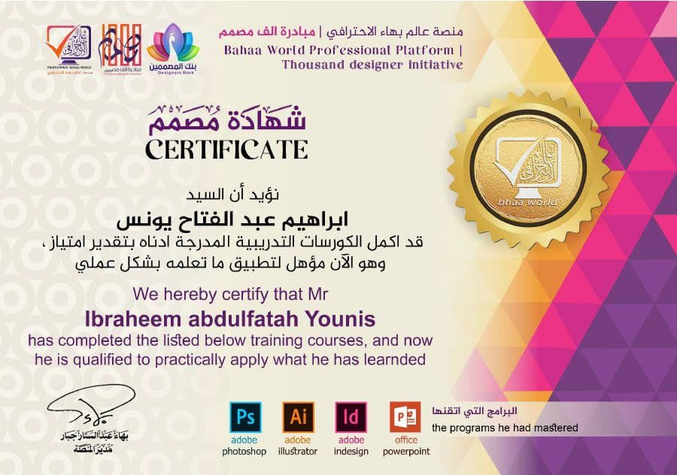
Certifications
I obtained in the field of design

Slide 7
Project Conclusion
I will continue to develop my design capabilities in order to become a professional designer and provide a service in the field of design for anyone who needs it, which is one of the very important areas in our lives now

