Slide 1
Elderly Tourism Project
Submitted by
MAHA SALIM IBRAHIM
BSc., Translation
Graduate from University of Mosul
(WhatsApp: +964 773 849 9186)
Supervised by
Prof. Dr., AHMED ABDULGANI TAHA (aat@uomosul.edu.iq)
Asst Prof. Dr., MOHAMMAD THAKER SALIM (mthsa@uomosul.edu.iq)

Slide 2
Introduction
Due to the nature of life within Iraqi society, older persons suffer from strong psychological and health pressures.
Health pressures relate to diseases such as diabetes, hypertension, joints and obesity
Psychological pressures relate to the general Iraqi situation, crises, wars and often insecurity.

Slide 3
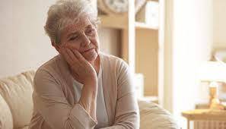
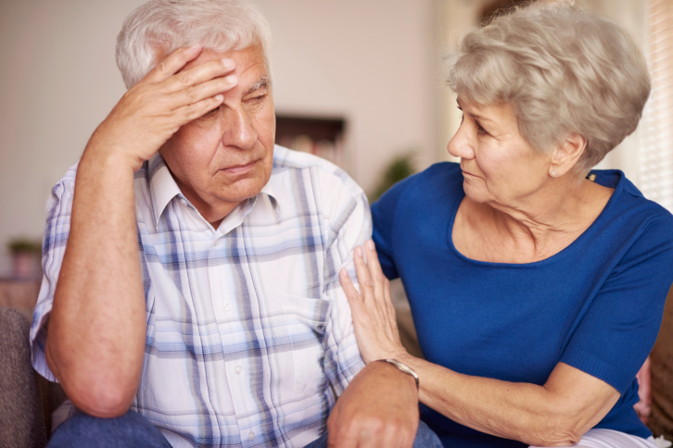

Slide 4
Introduction
The composition of the Iraqi personality of the elderly is quite different from what is common in the rest of the world. Even after he (she) retires, he still links his problems to his adult children and grandchildren, and he thinks he's still responsible for them.

Slide 5
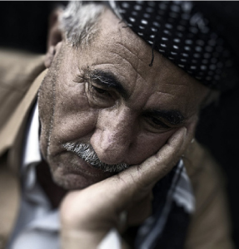

Slide 6
Objectives of the Project
The project aims to create jobs to:
Social workers,
psychologists,
fitness trainers and
health and tourism workers

Slide 7
Project costs
The proposed tourism project includes opening an office at low costs in an uncrowded and cheap rental area that the office adopts in promoting through social media pages
Agreement or contract with the authorities at reduced and continuous fares:
A number of owners of tourist vehicles and air-conditioned buses
Event halls
Gyms or swimming pool
Tourist sites

Slide 8
Services provided by the Project

Slide 9
Recreational Tourism
Inside Iraq and possibly outside it, organizing trips to tourist areas for the elderly and to be specific to the age group of these elderly as well as cultural specificity.

Slide 10
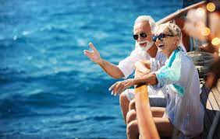

Slide 11
Medical tourism
Medical tourism includes facilitating the treatment of elderly patients inside and outside Iraq by receiving medical examination reports and presenting them to more than one medical entity for the purpose of selecting the most suitable for these patients with the possibility of gaining discounts for them.

Slide 12
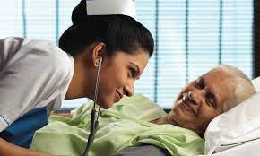

Slide 13
Religious Tourism
Organizing trips to visit religious places both inside and outside Iraq for older persons whose psychological state is linked to this type of visit.

Slide 15
Marketing of healthy foods
A section of the project office is dedicated to selling healthy food products for the elderly and can also be marketed online.

Slide 16
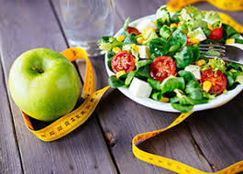

Slide 17
Nutritional and physical awareness
Inside the office of the project, a kitchen is dedicated to courses to teach how to make simple healthy foods.
Organizing awareness workshops that may be online or booking a large hall where nutritional guidelines and guidance on the behavior of older persons in their daily lives, especially those with chronic diseases.
Organizing fitness and treatment courses for the elderly by coordinating with gyms or swimming pool, booking specific days of the week and agreeing with a fitness trainer to devote a rehabilitation program for these ages

Slide 18
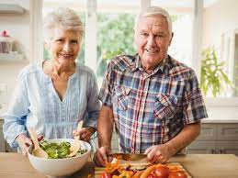
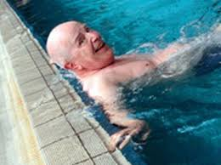
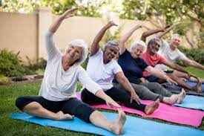

Slide 19
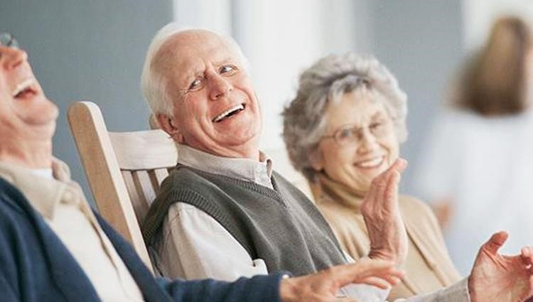
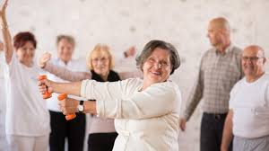

Slide 20
Psychological awareness
Psychological guidance and awareness to remove or be free from stresses of daily life and problems of children and grandchildren.
Guidance and panel discussions on ways to deal with crises
Psychological programs can be integrated into office-organized tourist and religious trips

Slide 21
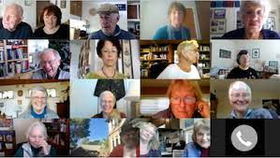
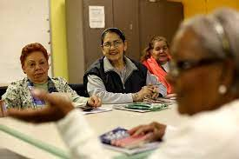

Slide 22
Thank you for your Listen
MAHA

